Slide 1
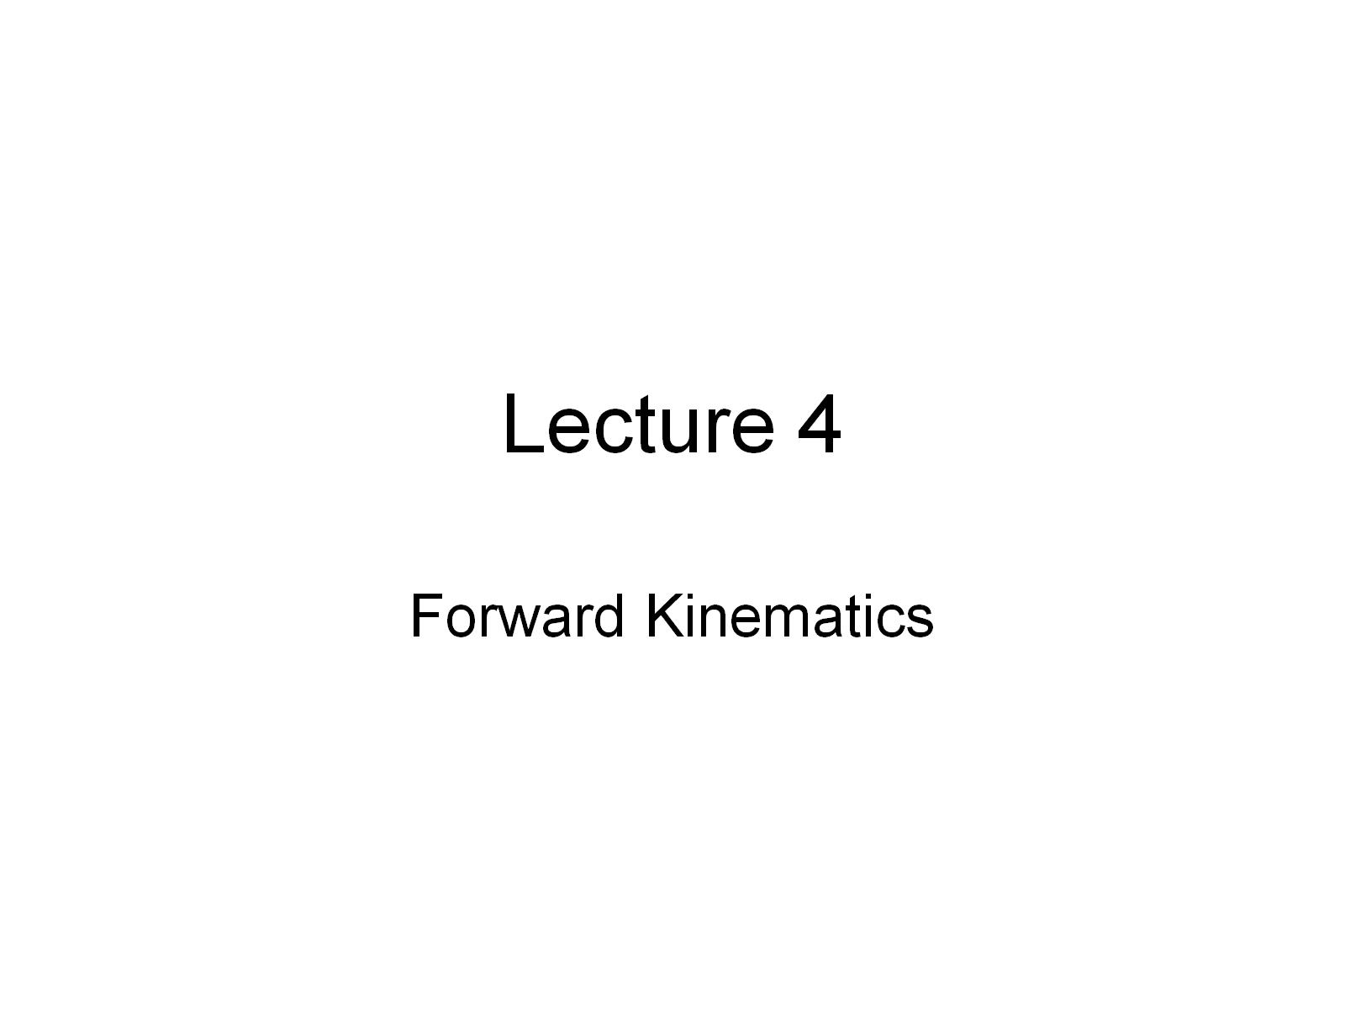
Lecture 4

Slide 2
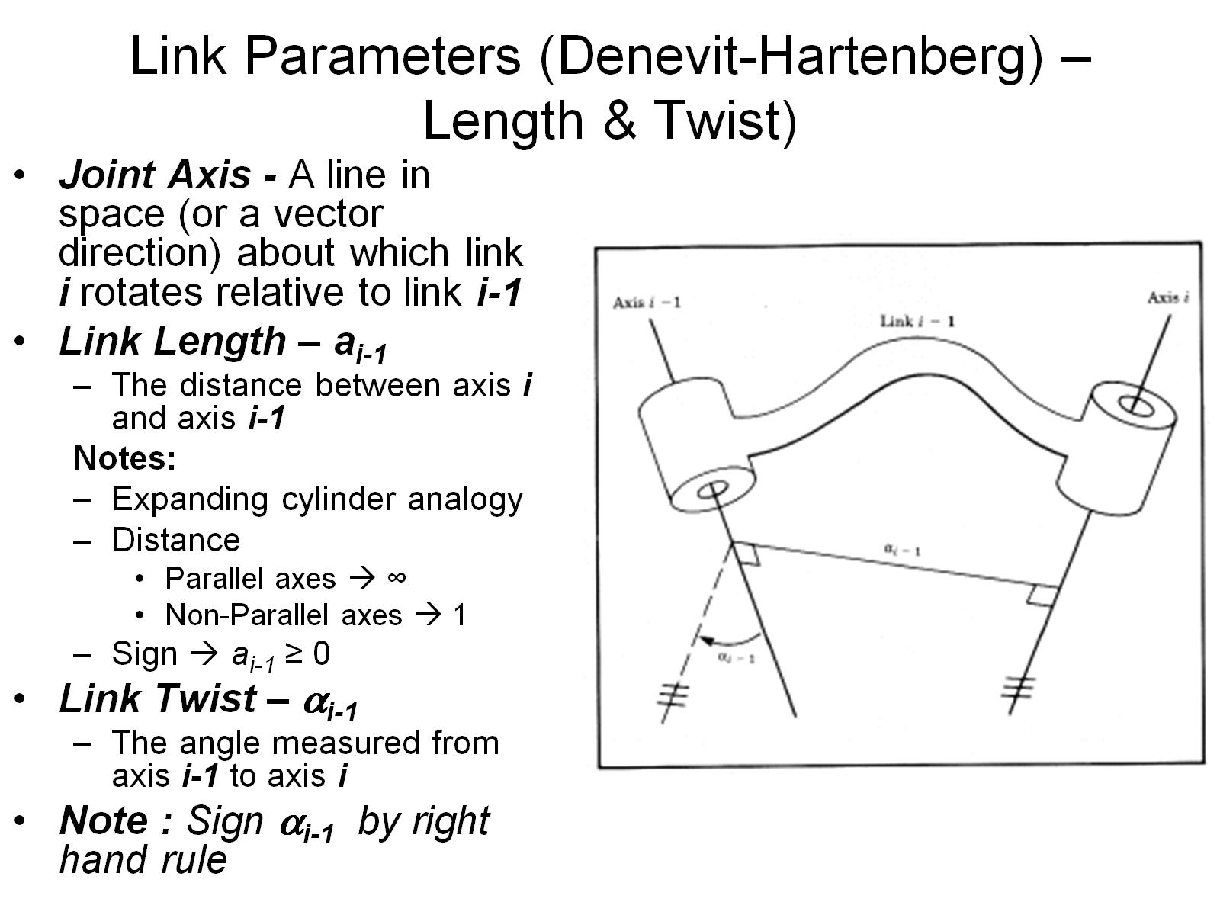
Link Parameters (Denevit-Hartenberg) – Length & Twist)

Slide 3
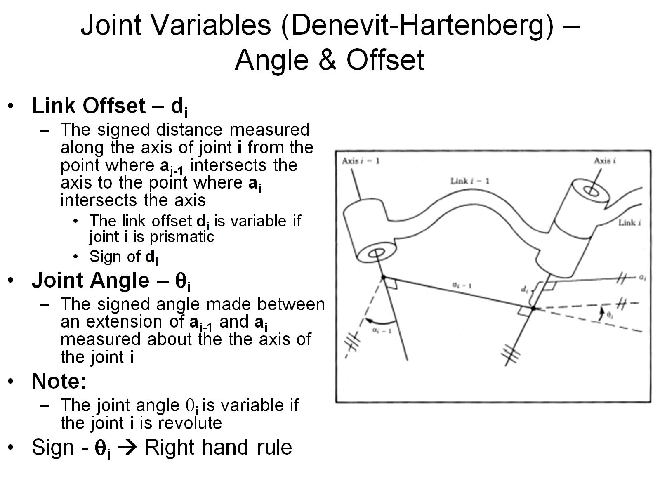
Joint Variables (Denevit-Hartenberg) – Angle & Offset

Slide 4
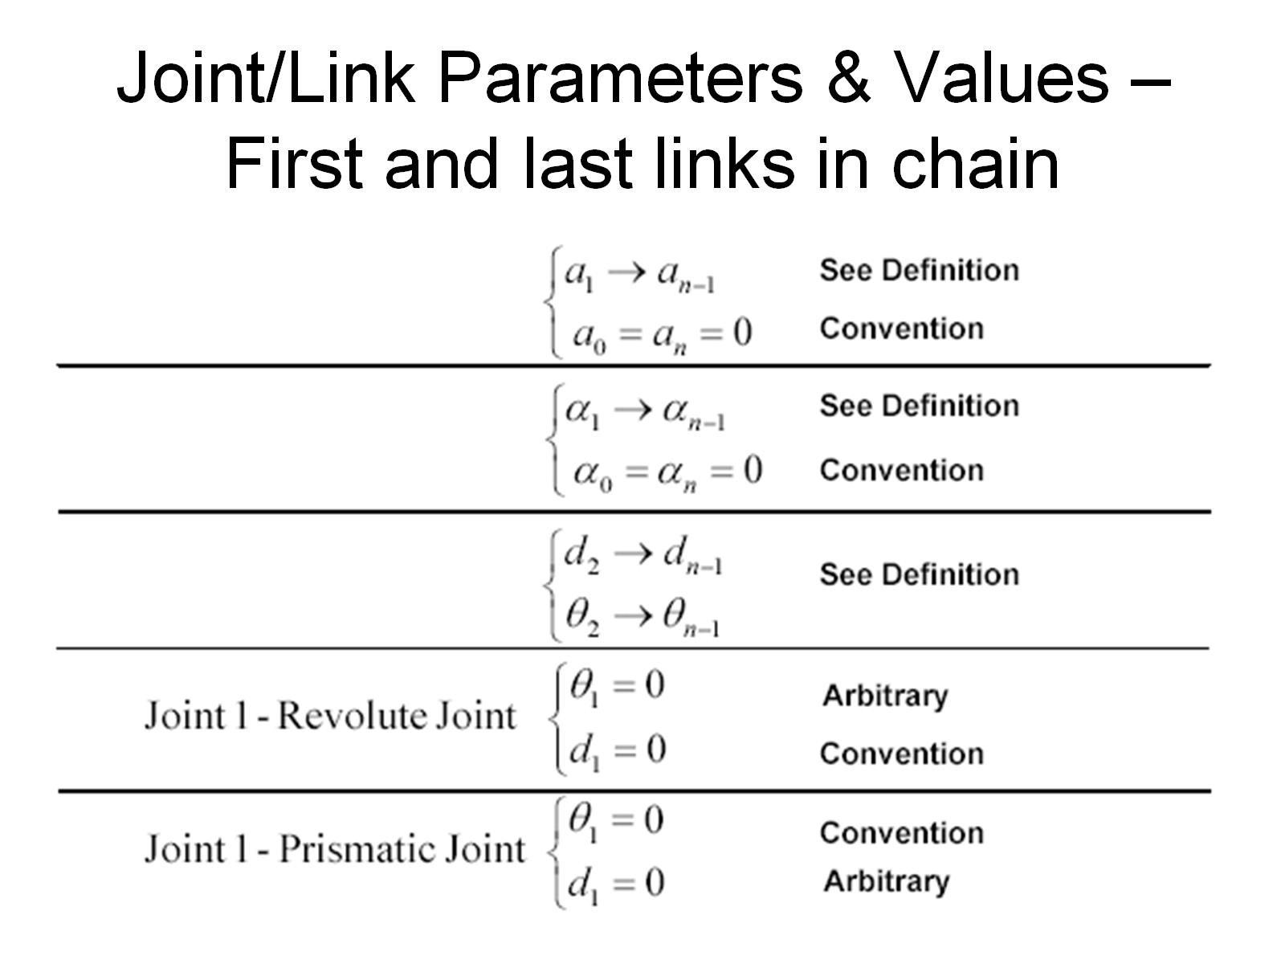
Joint/Link Parameters & Values – First and last links in chain

Slide 5
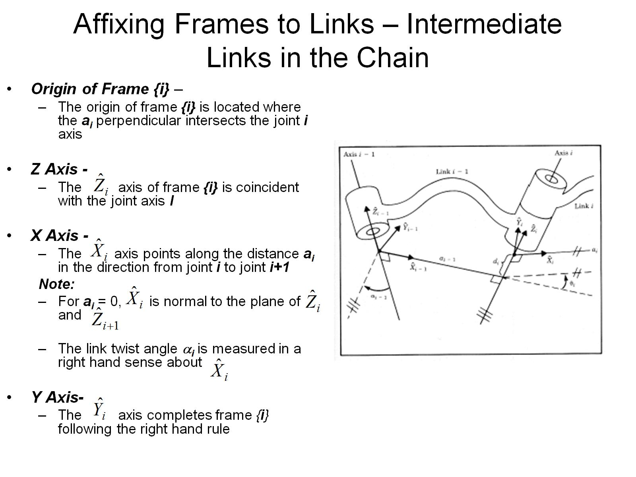
Affixing Frames to Links – Intermediate Links in the Chain

Slide 6
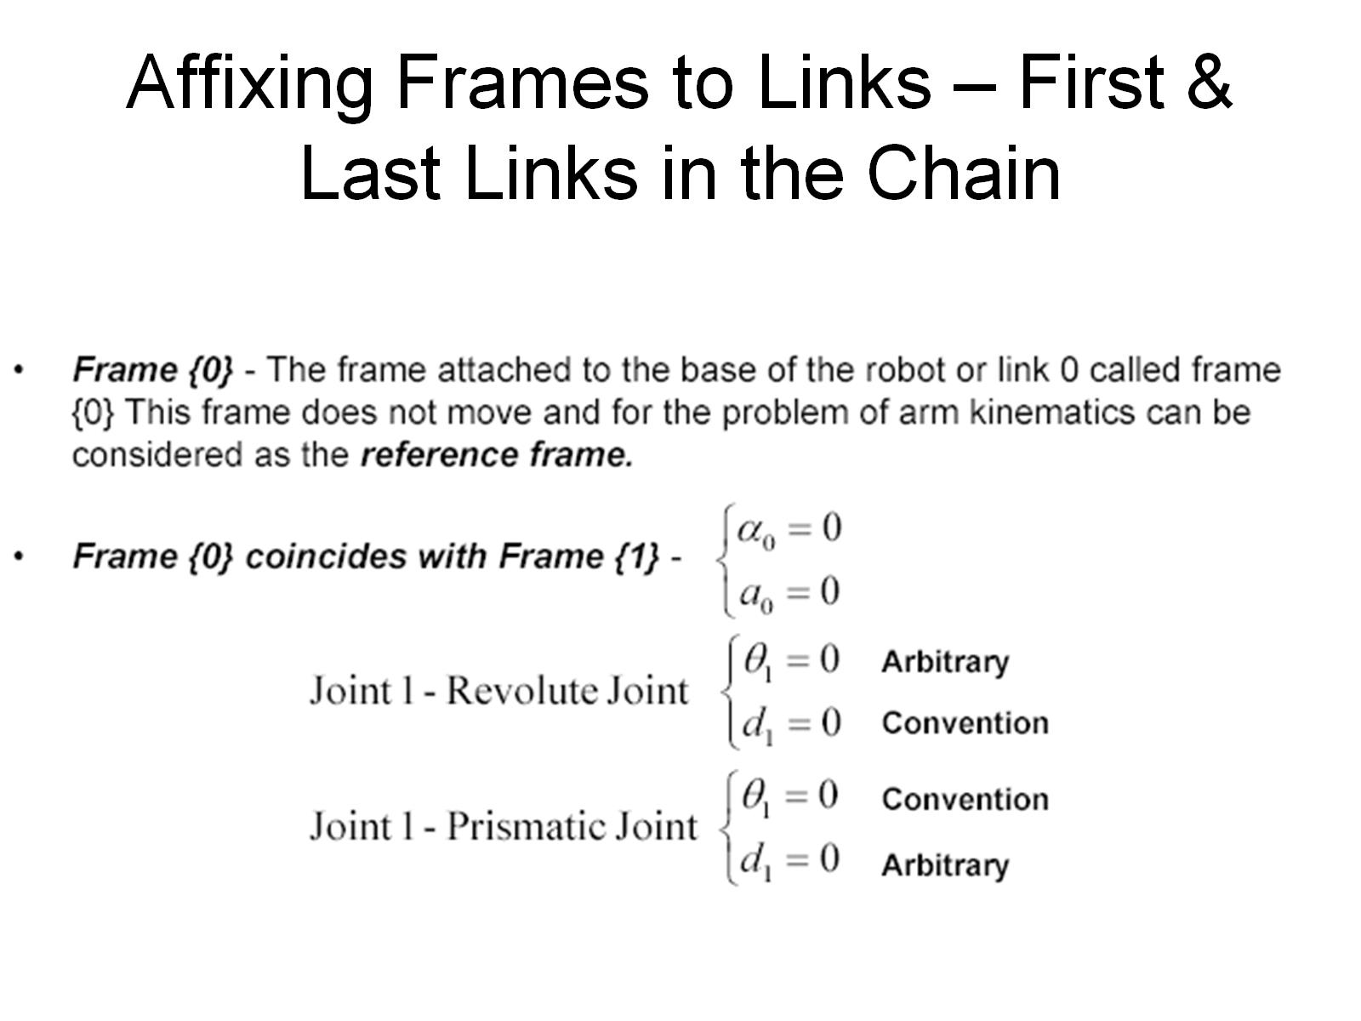
Affixing Frames to Links – First & Last Links in the Chain

Slide 7
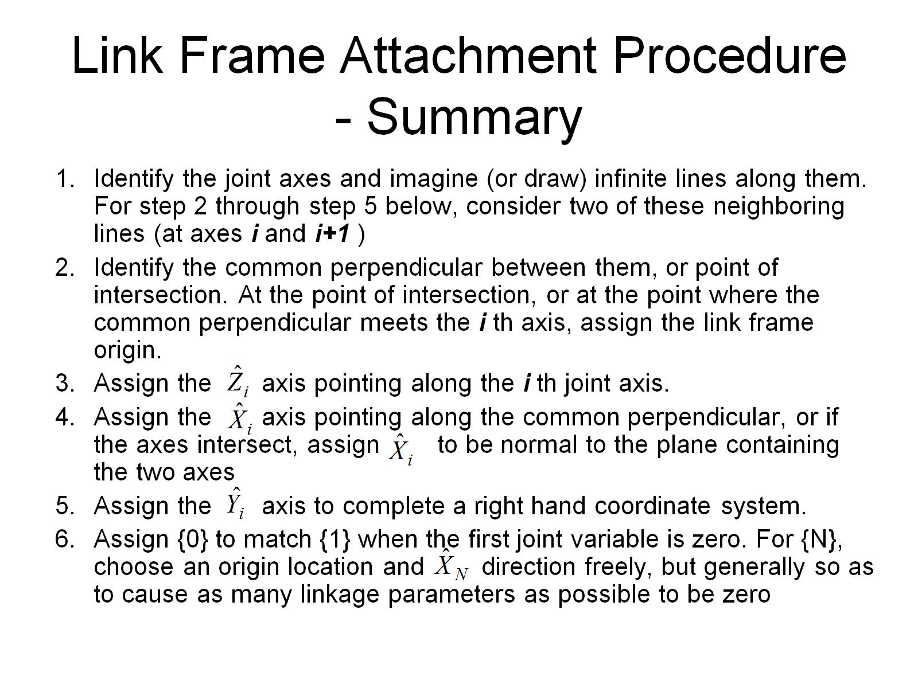
Link Frame Attachment Procedure - Summary

Slide 8
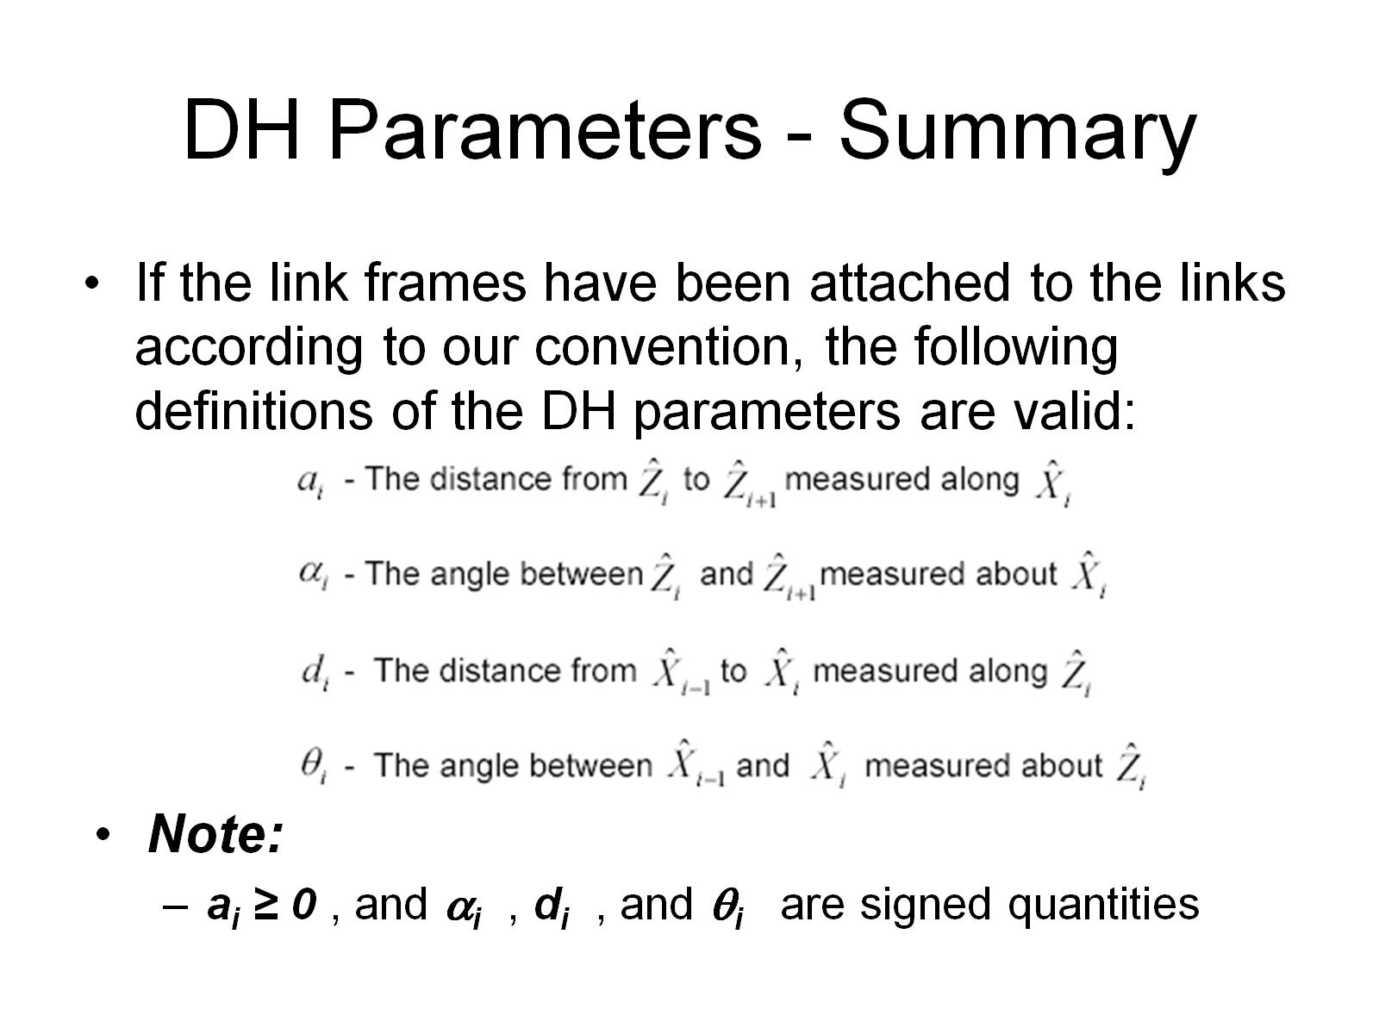
DH Parameters - Summary

Slide 9
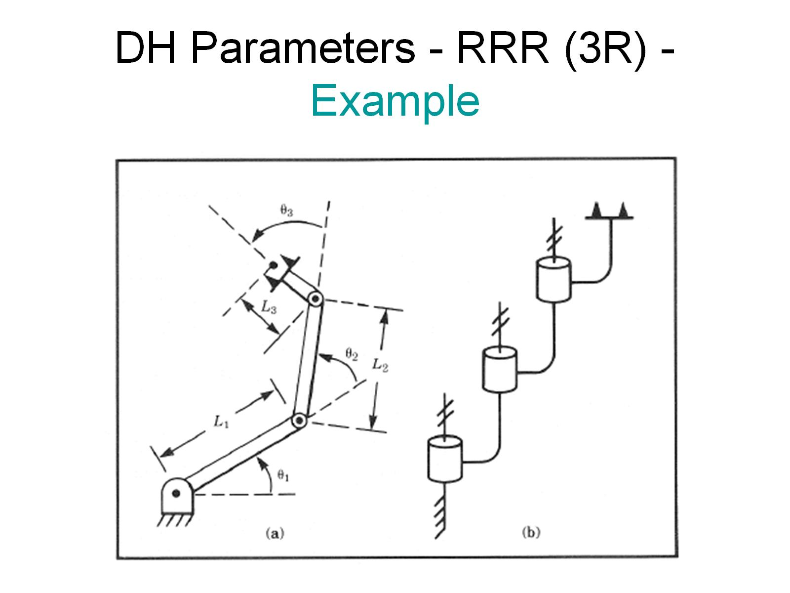
DH Parameters - RRR (3R) - Example

Slide 10
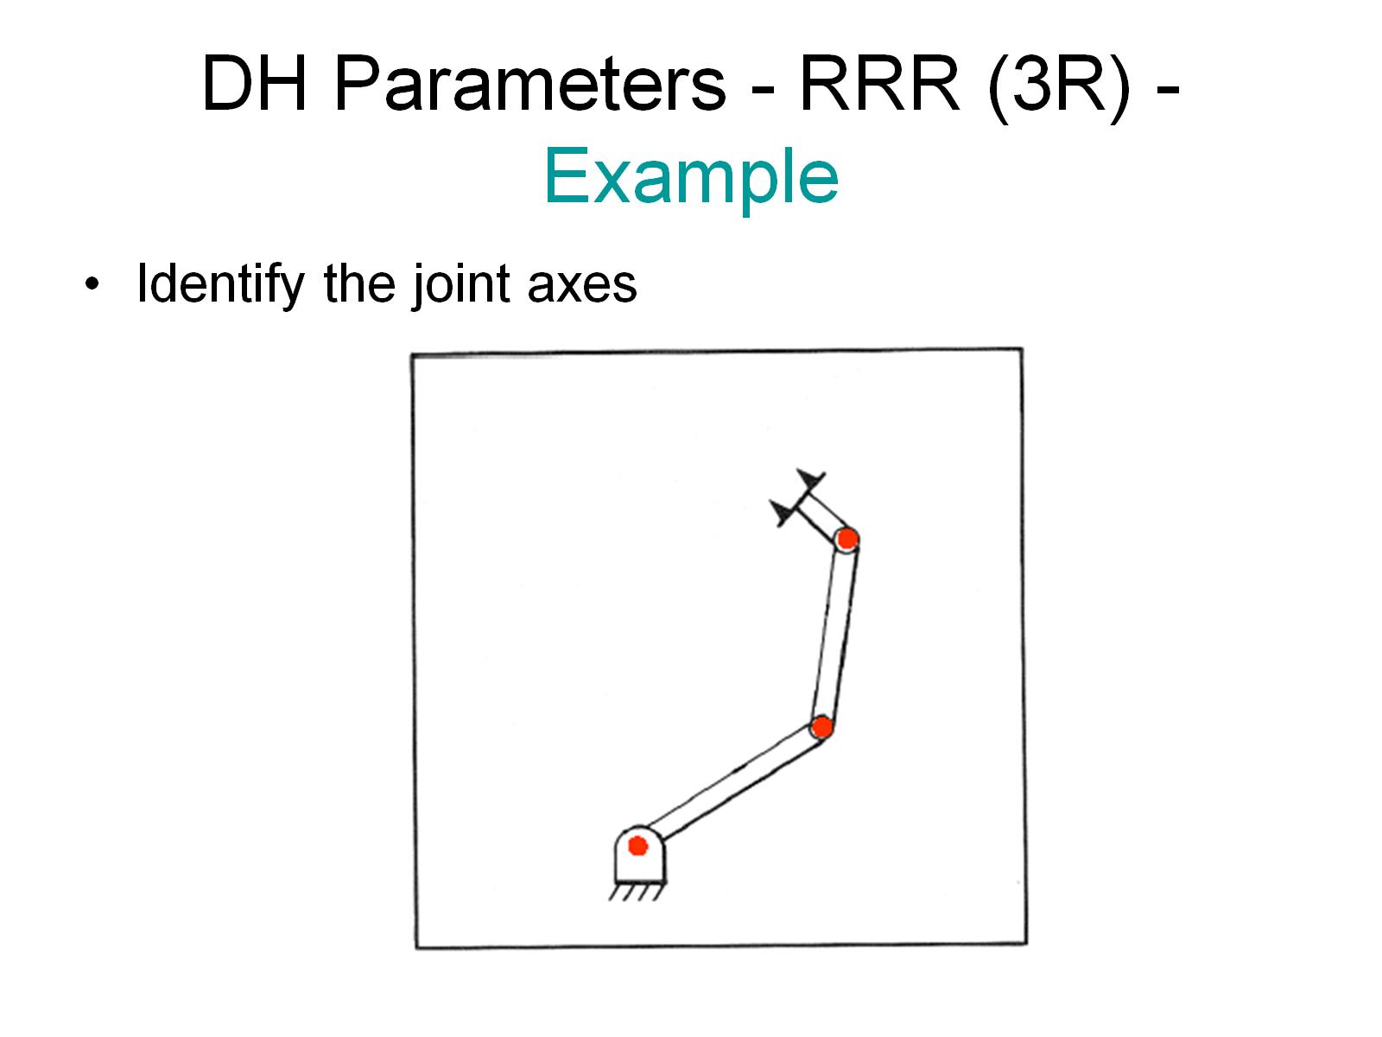
DH Parameters - RRR (3R) - Example

Slide 11
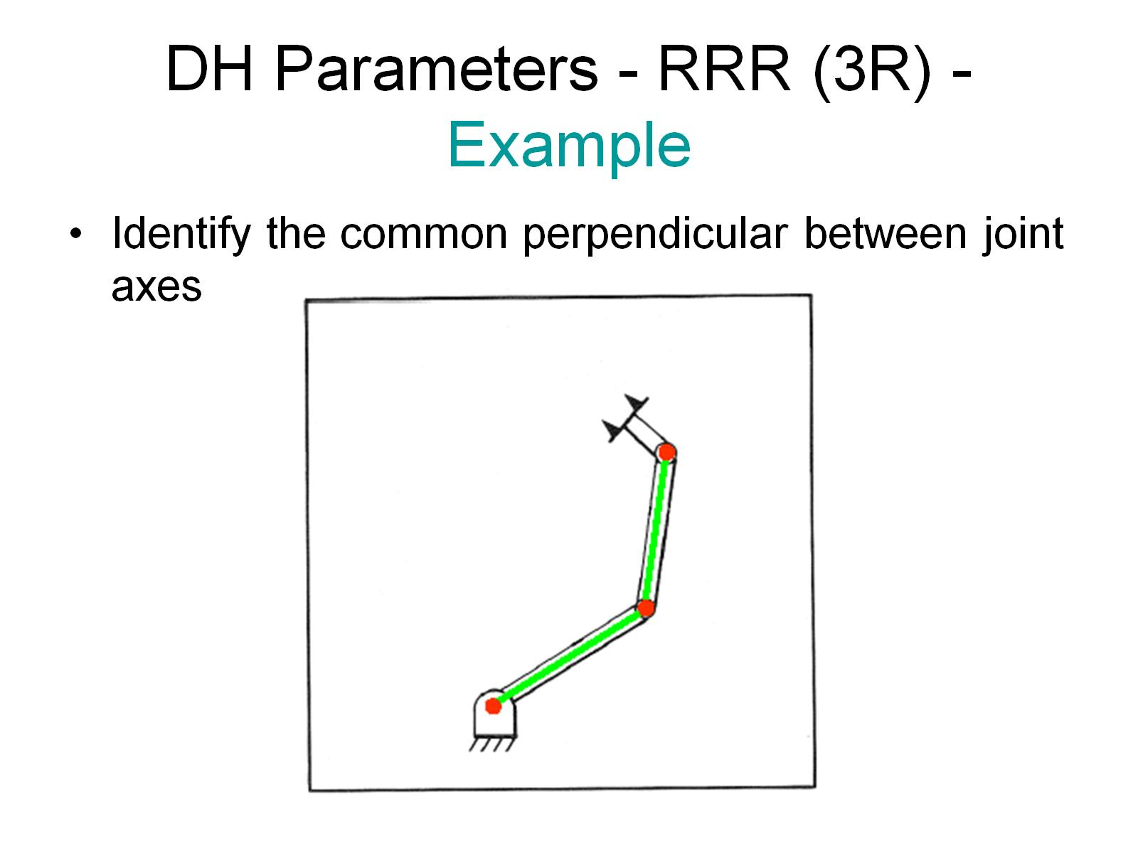
DH Parameters - RRR (3R) - Example

Slide 12
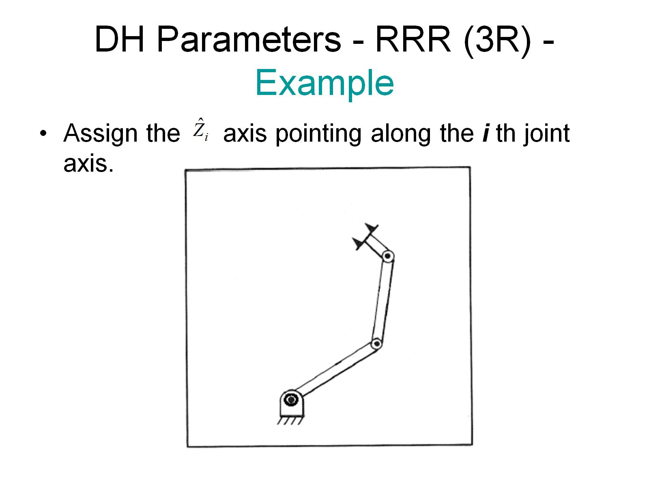
DH Parameters - RRR (3R) - Example

Slide 13
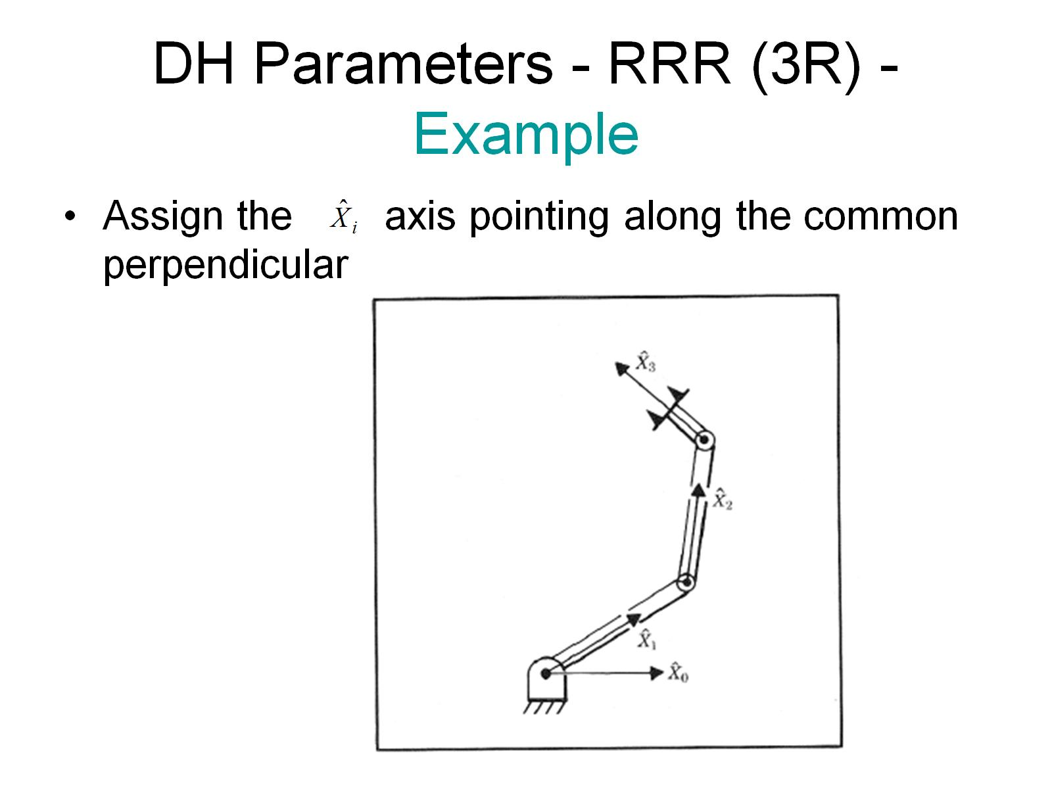
DH Parameters - RRR (3R) - Example

Slide 14
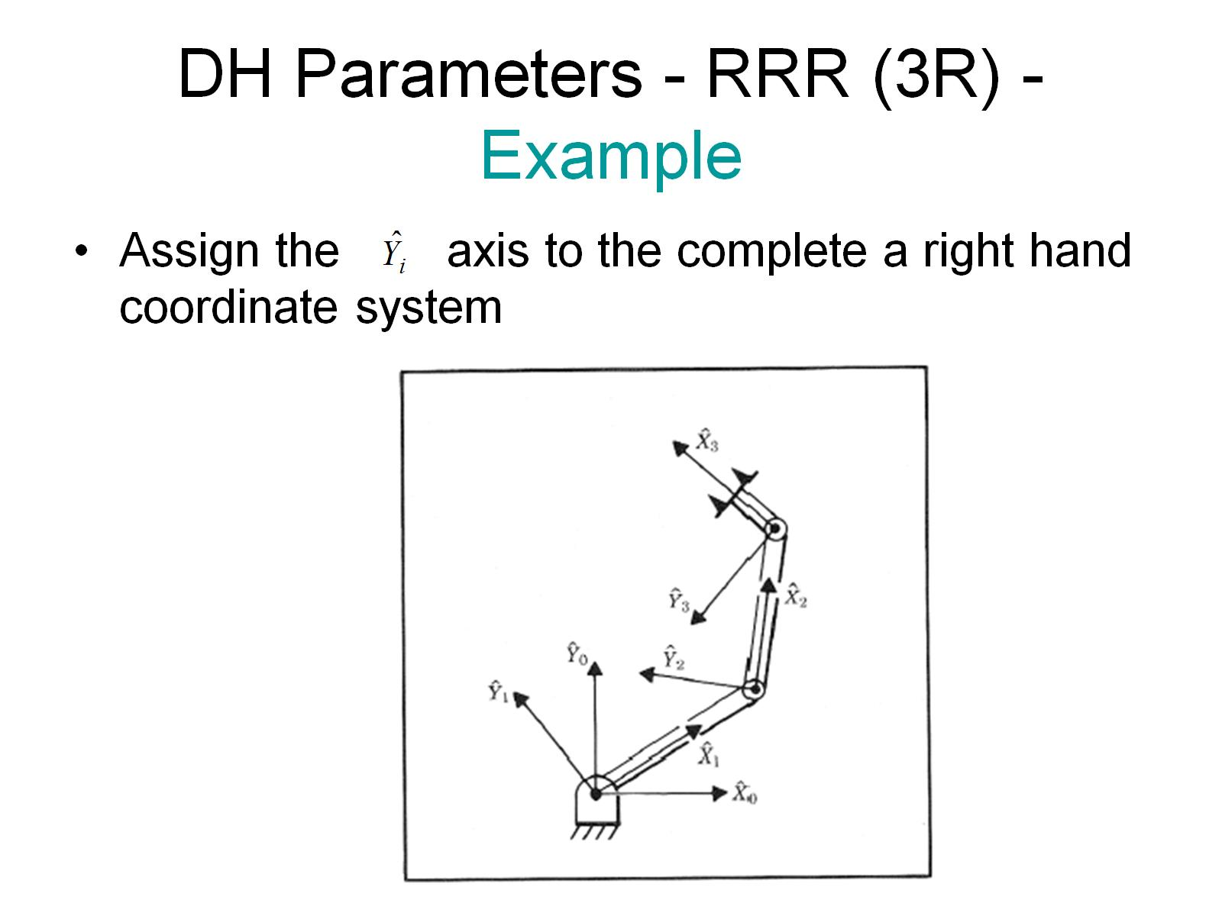
DH Parameters - RRR (3R) - Example

Slide 15
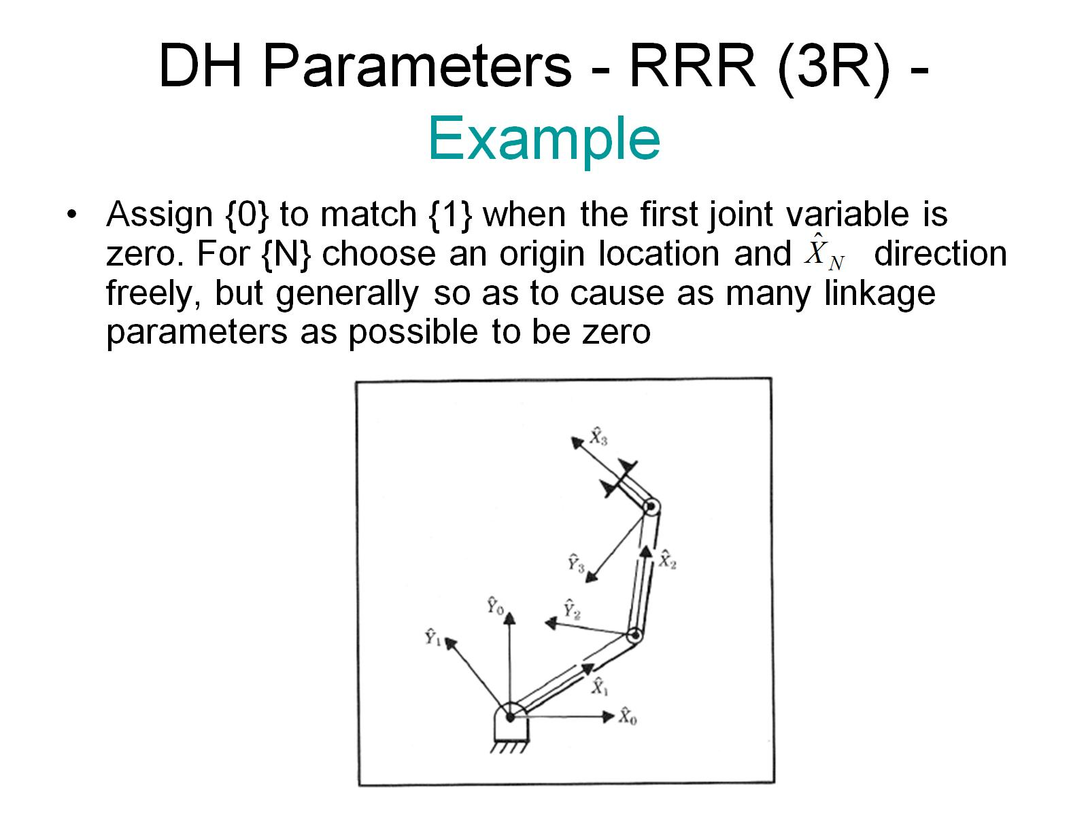
DH Parameters - RRR (3R) - Example

Slide 16
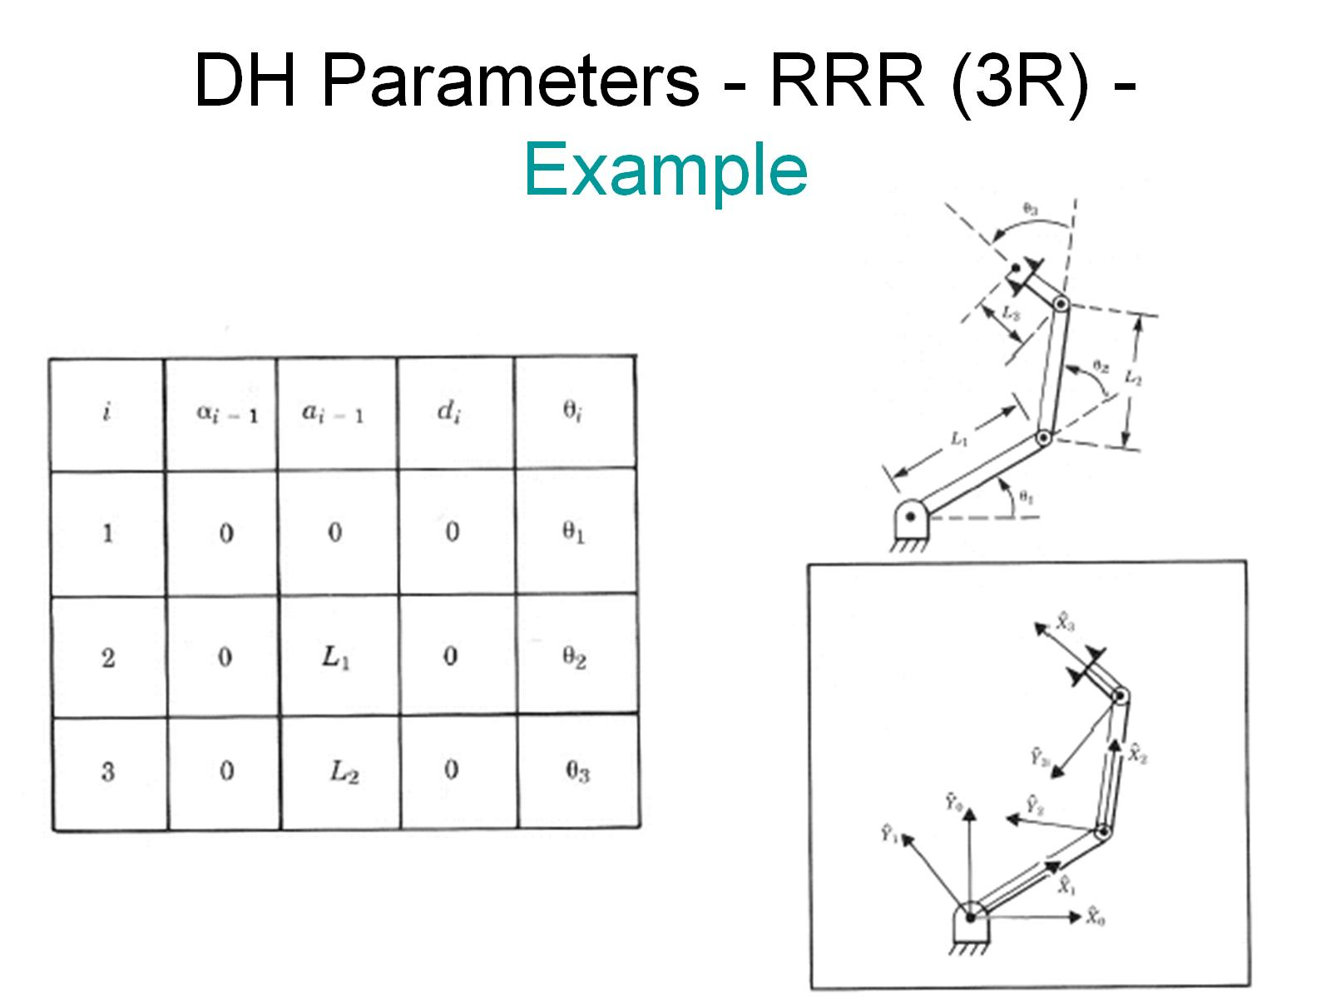
DH Parameters - RRR (3R) - Example

Slide 17
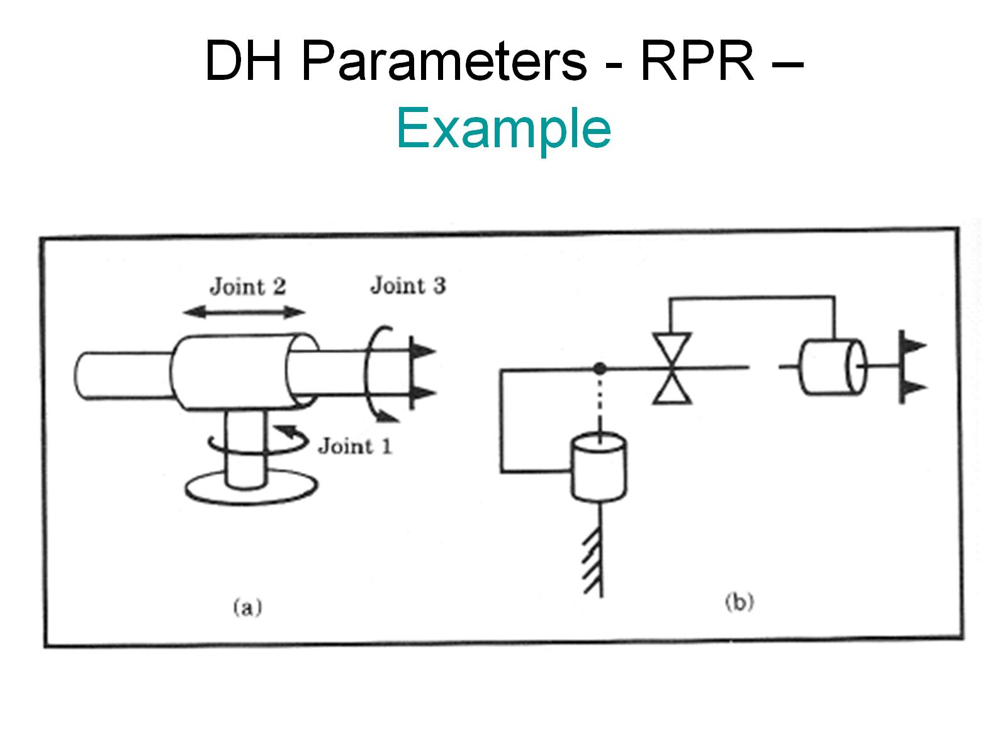
DH Parameters - RPR – Example

Slide 18
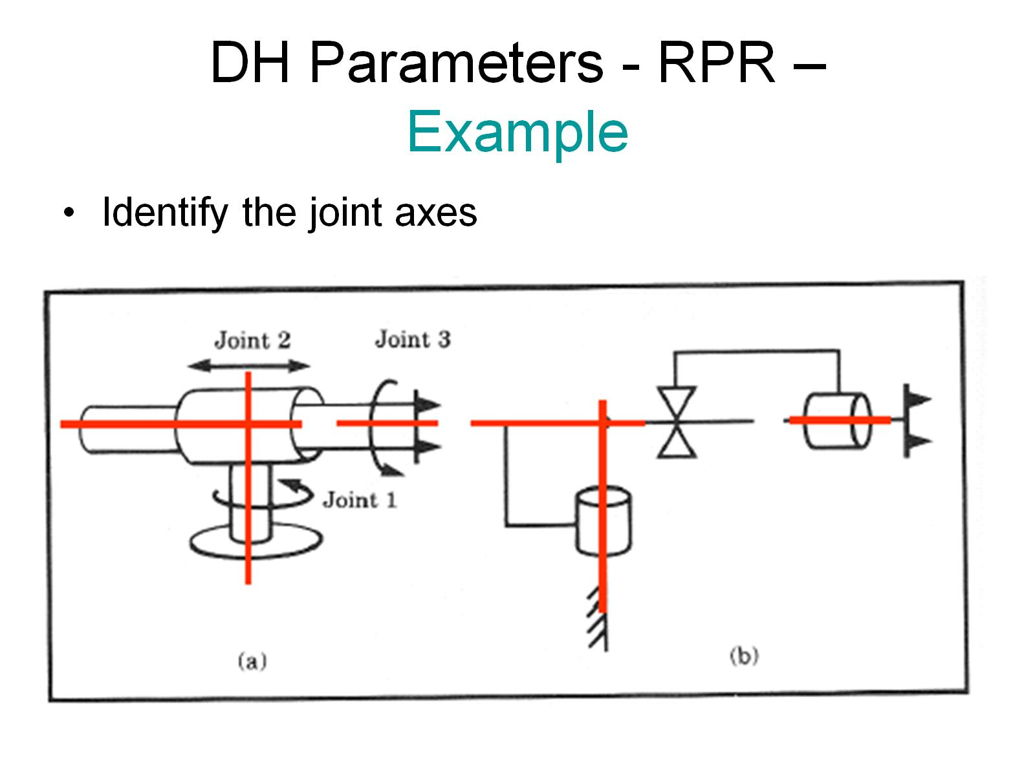
DH Parameters - RPR – Example

Slide 19
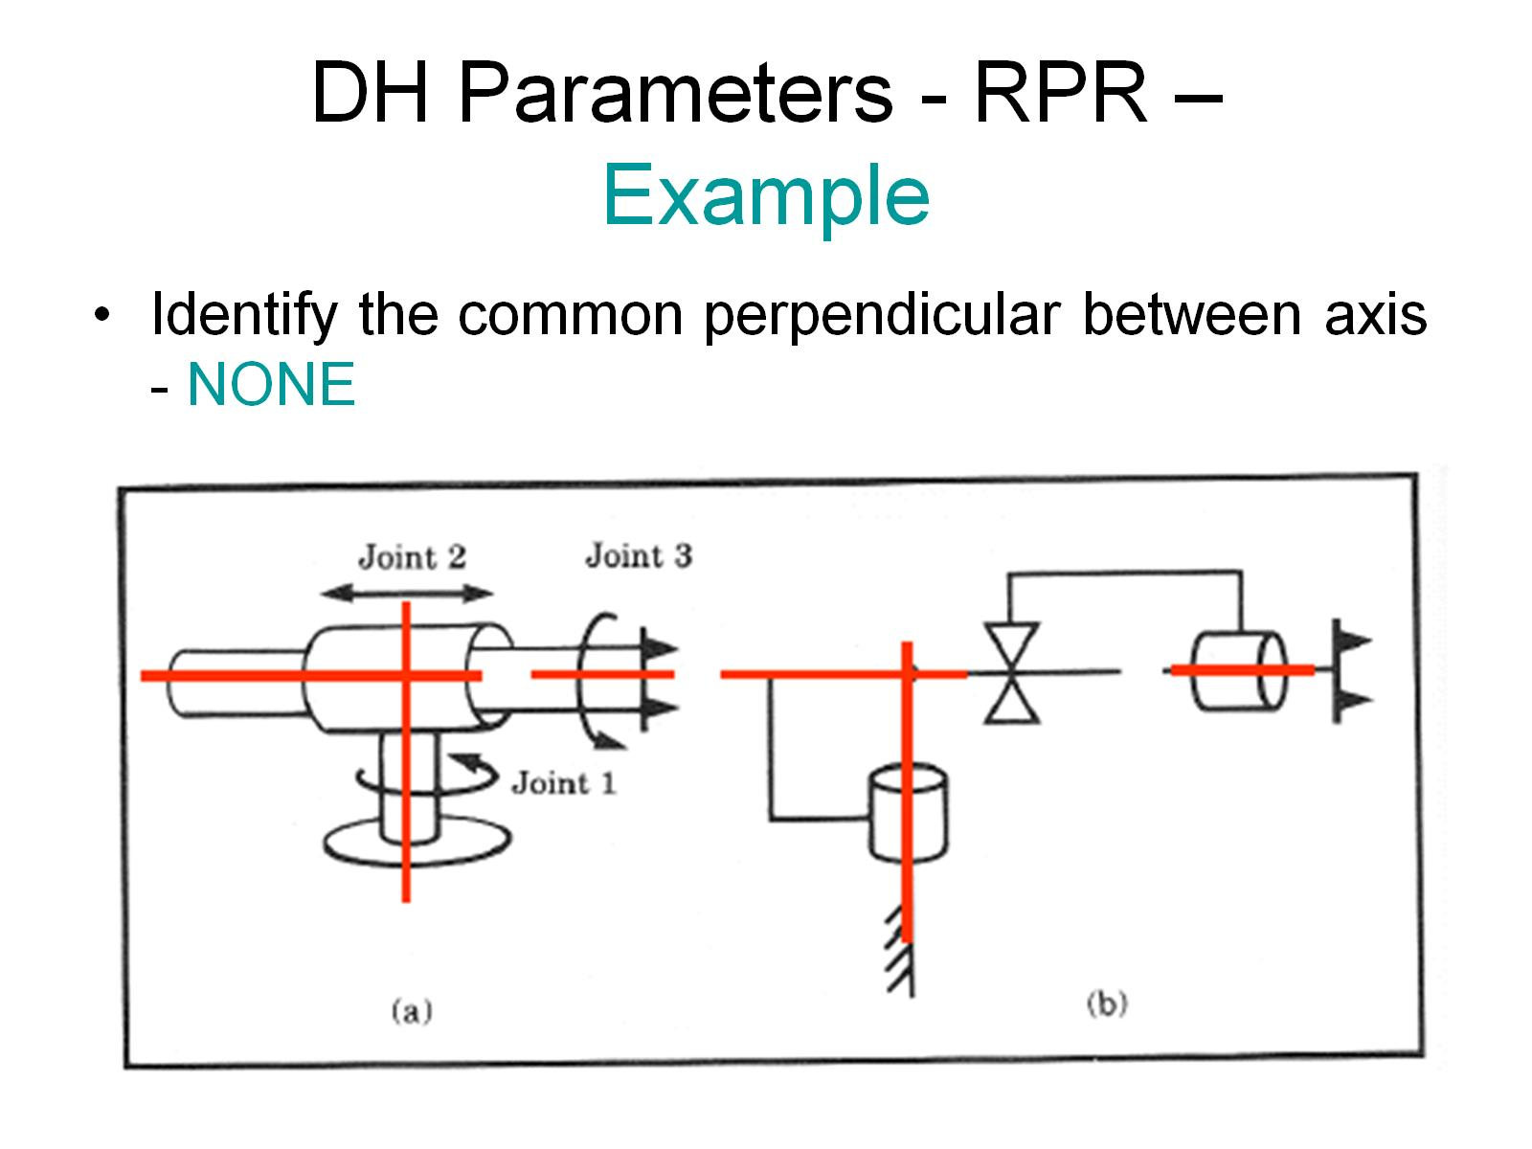
DH Parameters - RPR – Example

Slide 20
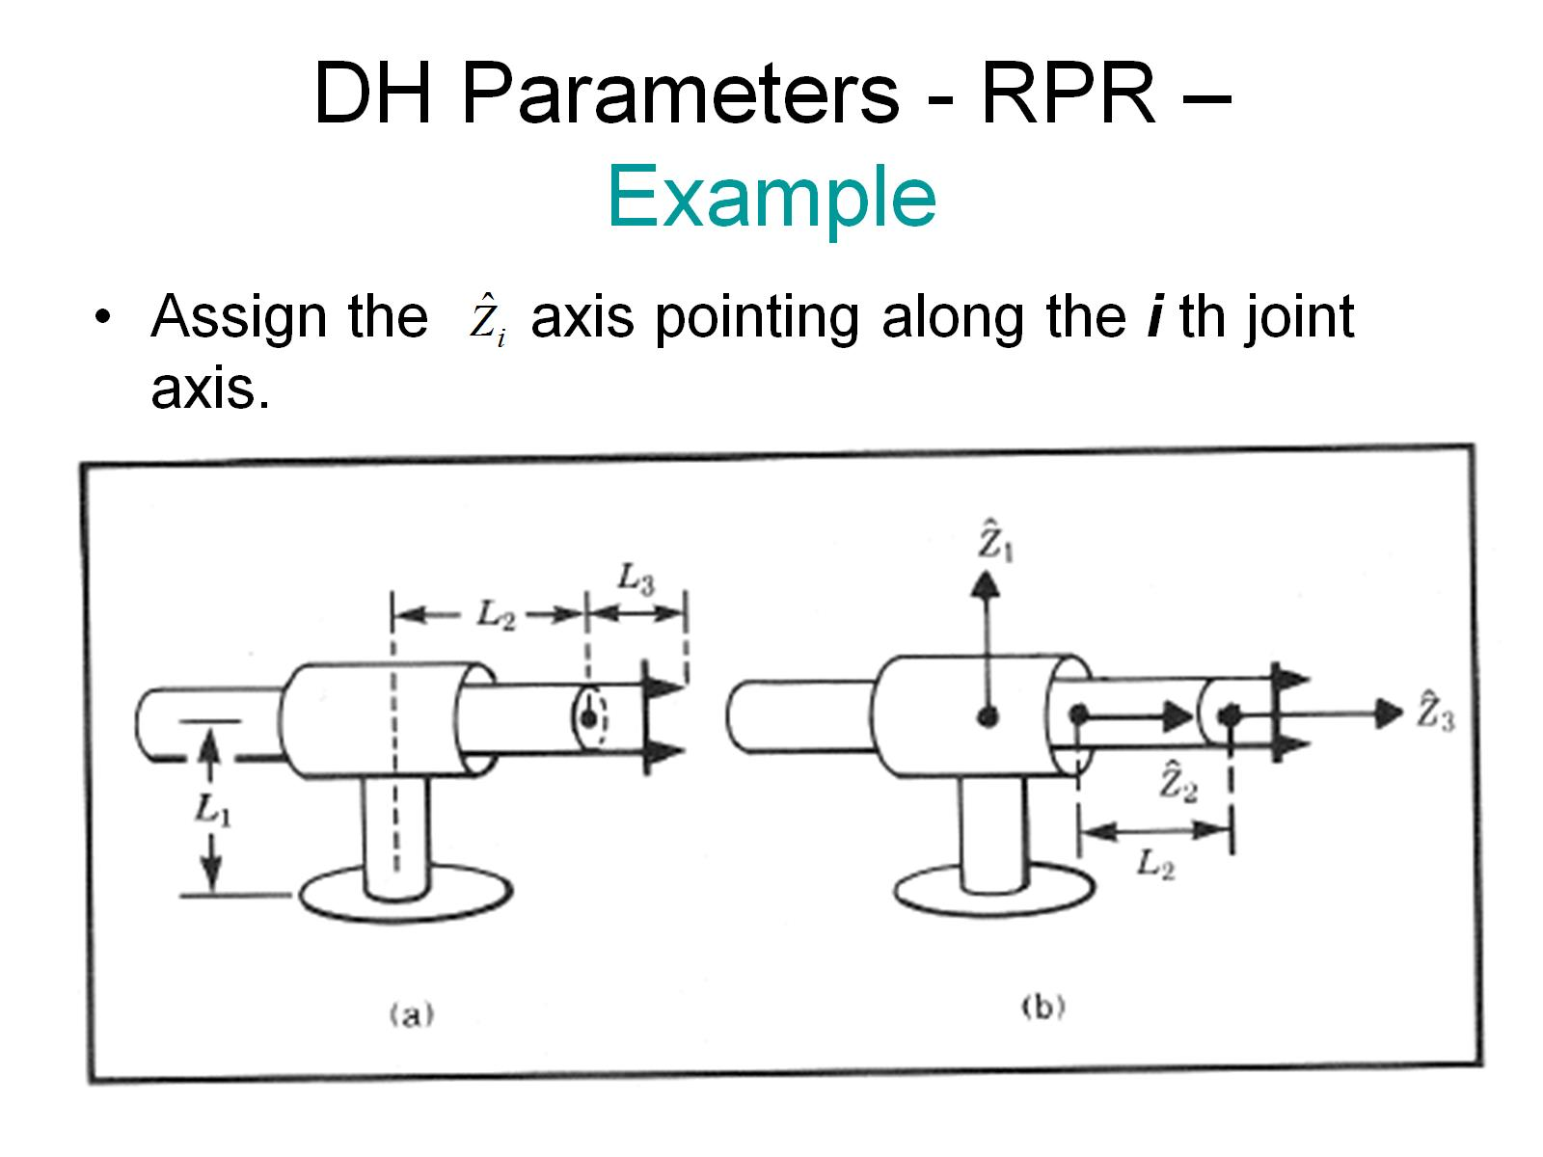
DH Parameters - RPR – Example

Slide 21
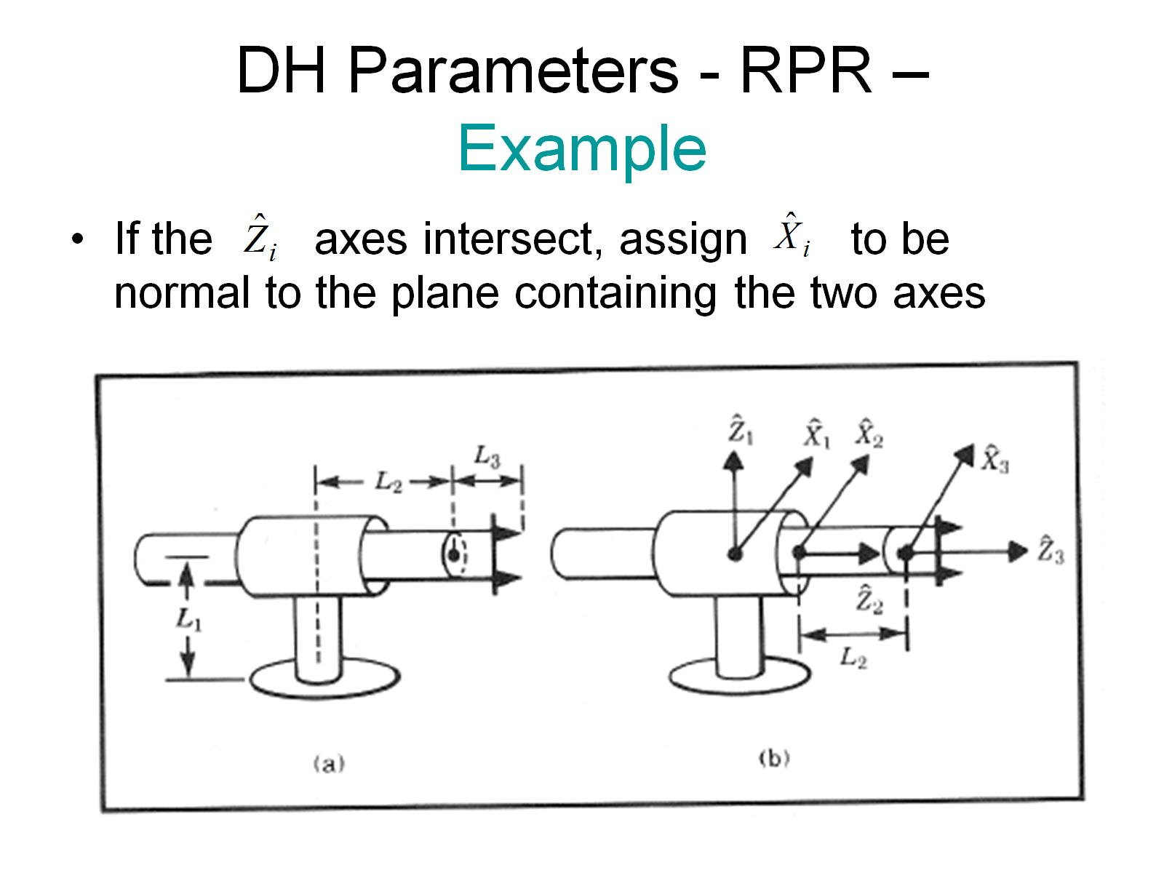
DH Parameters - RPR – Example

Slide 22
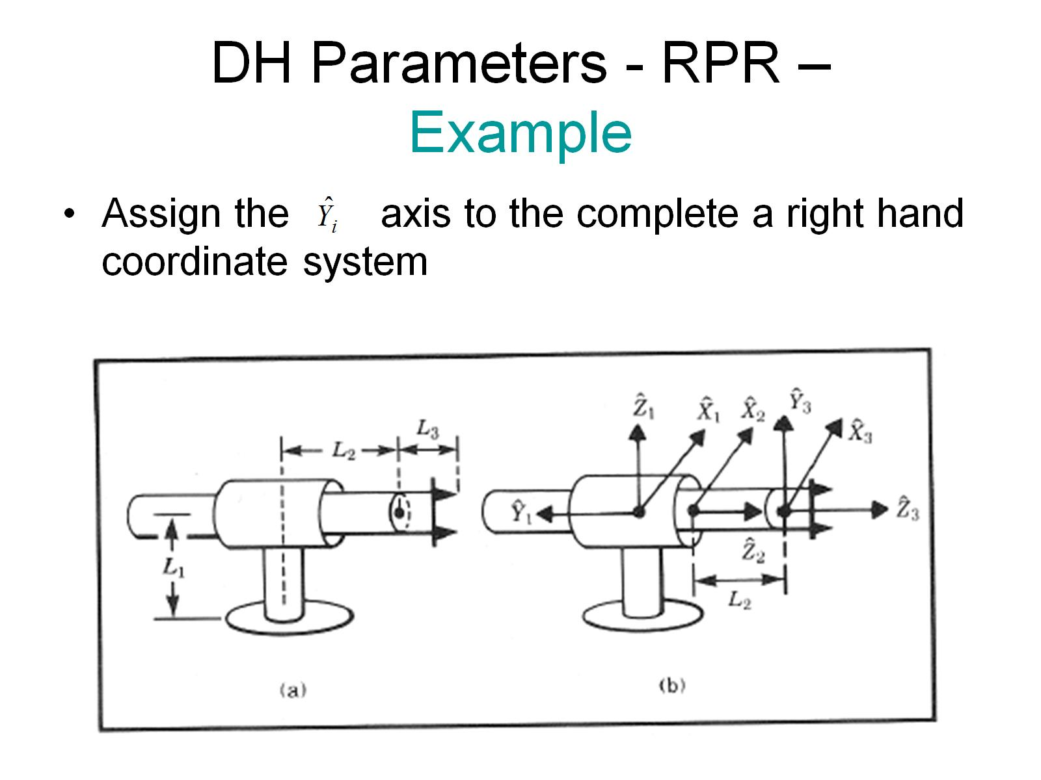
DH Parameters - RPR – Example

Slide 23
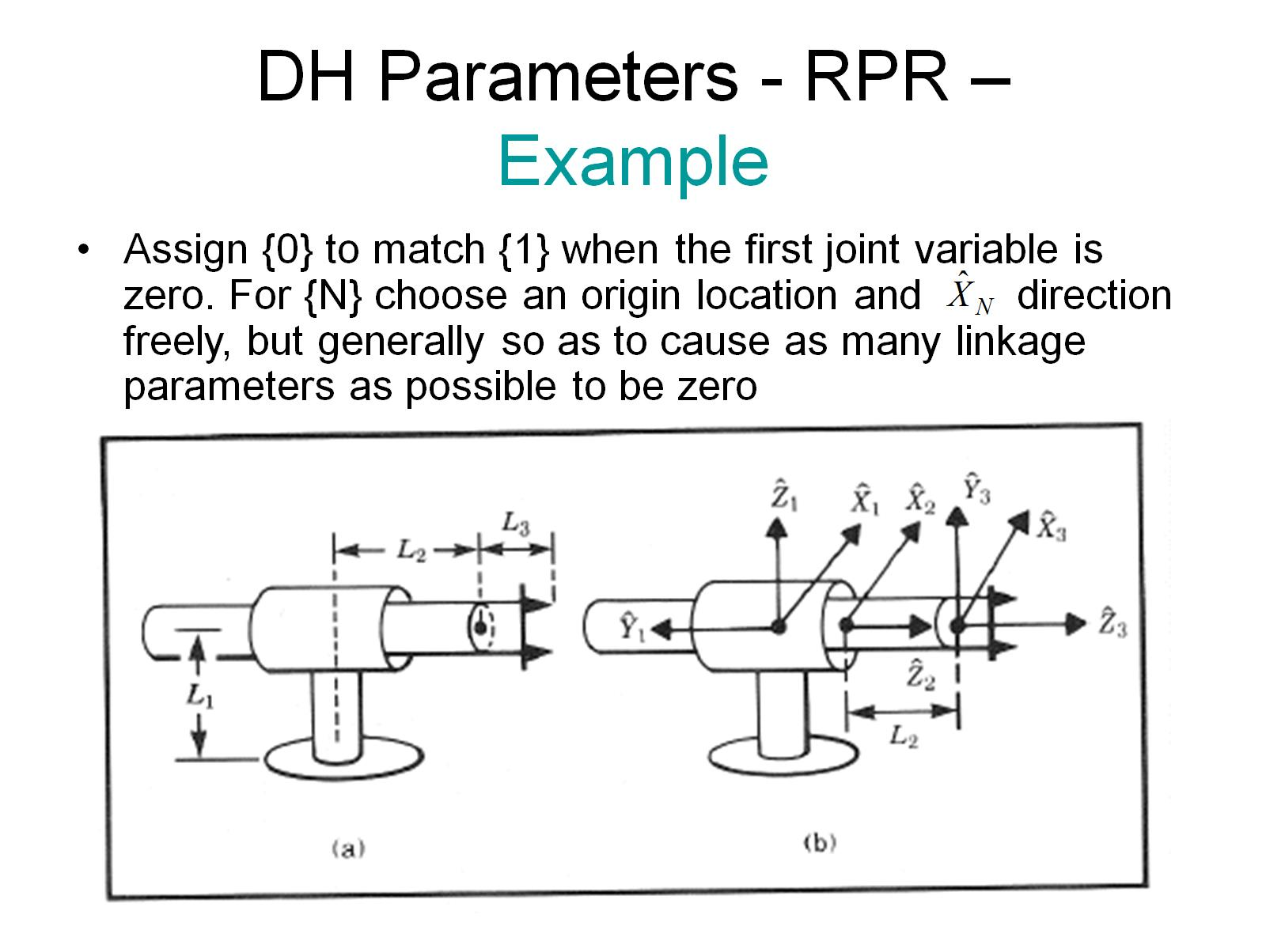
DH Parameters - RPR – Example

Slide 24
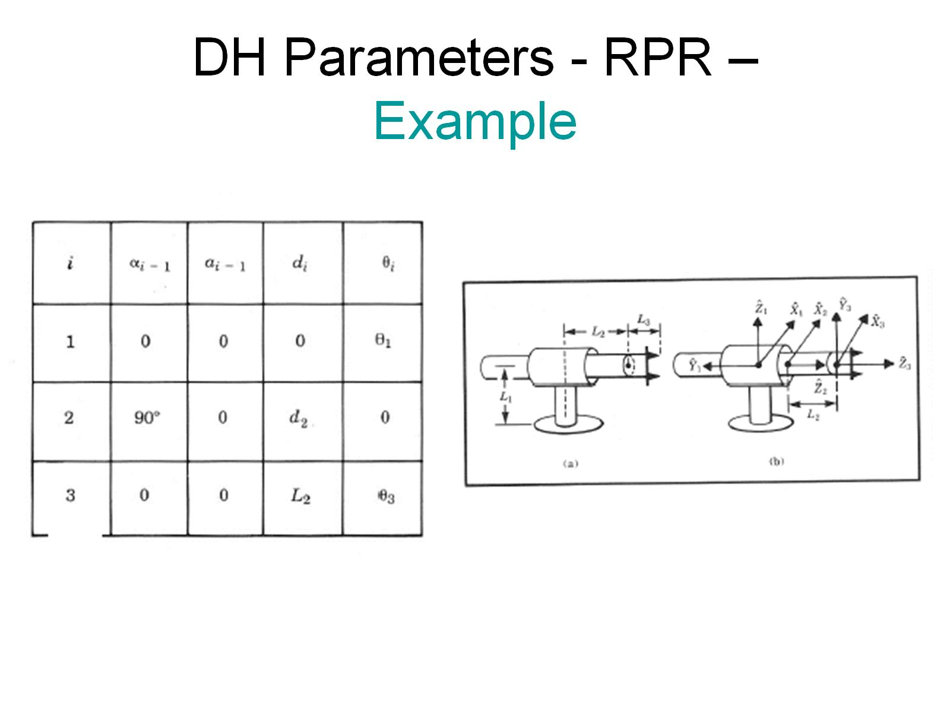
DH Parameters - RPR – Example

Slide 25
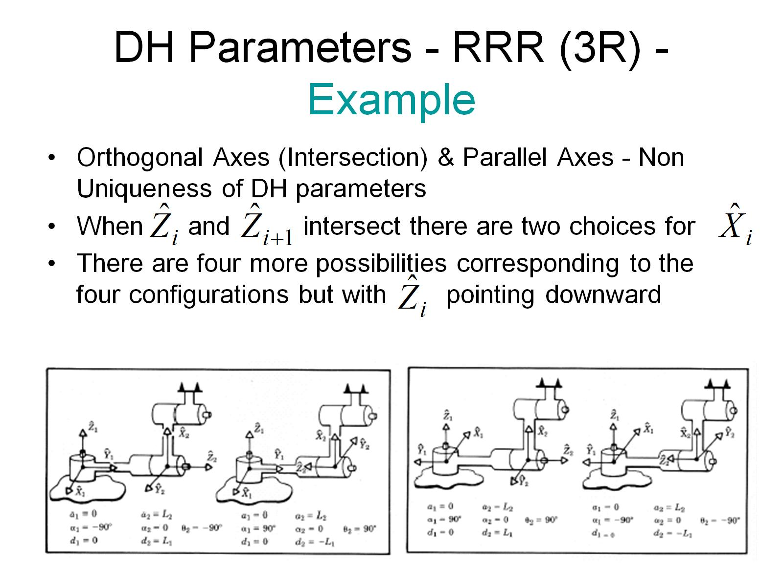
DH Parameters - RRR (3R) - Example

Slide 26
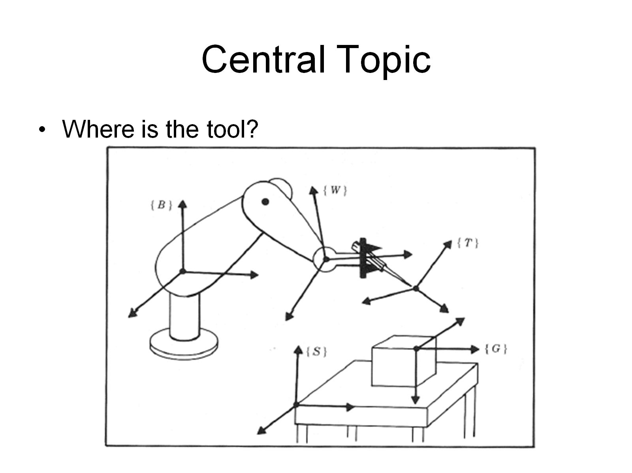
Central Topic

Slide 27
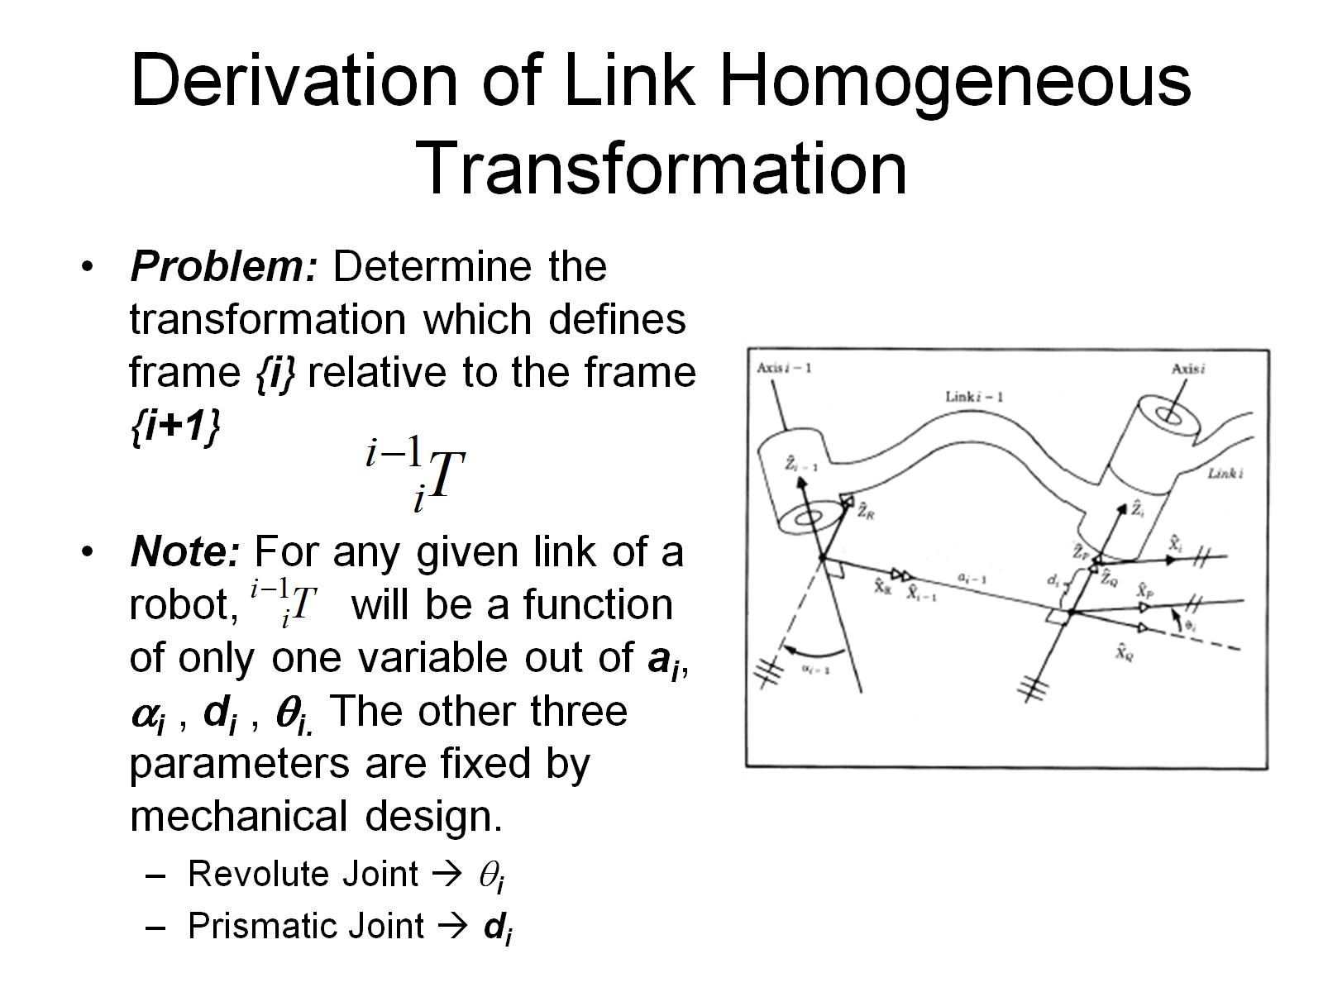
Derivation of Link Homogeneous Transformation

Slide 28
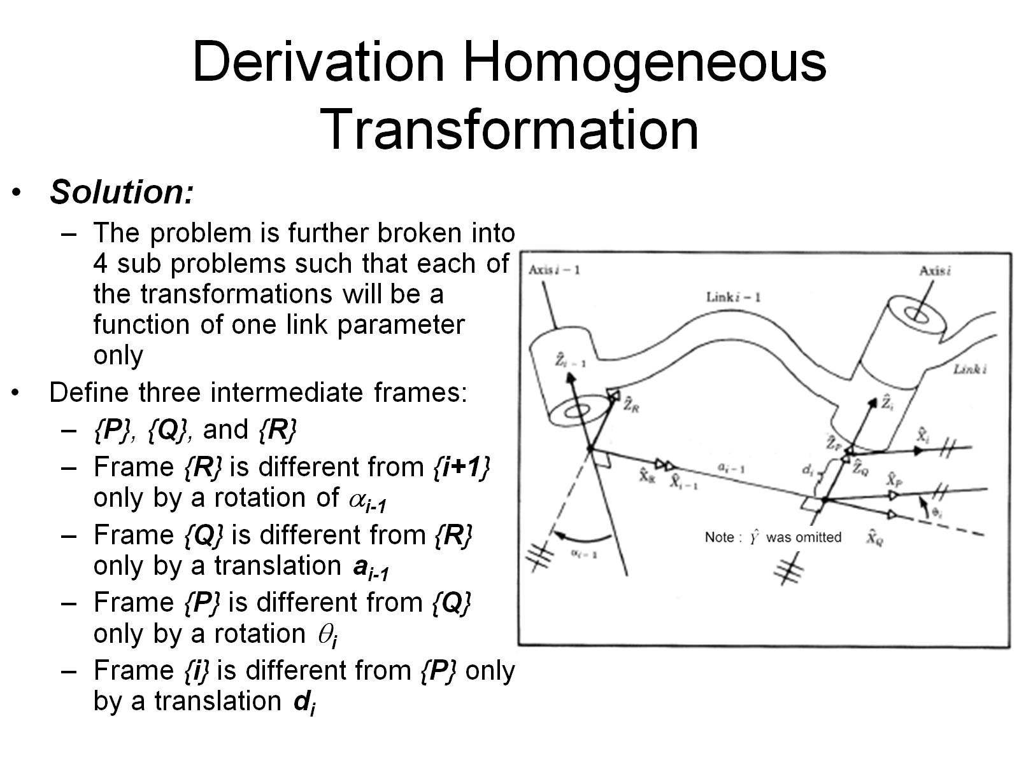
Derivation Homogeneous Transformation

Slide 29
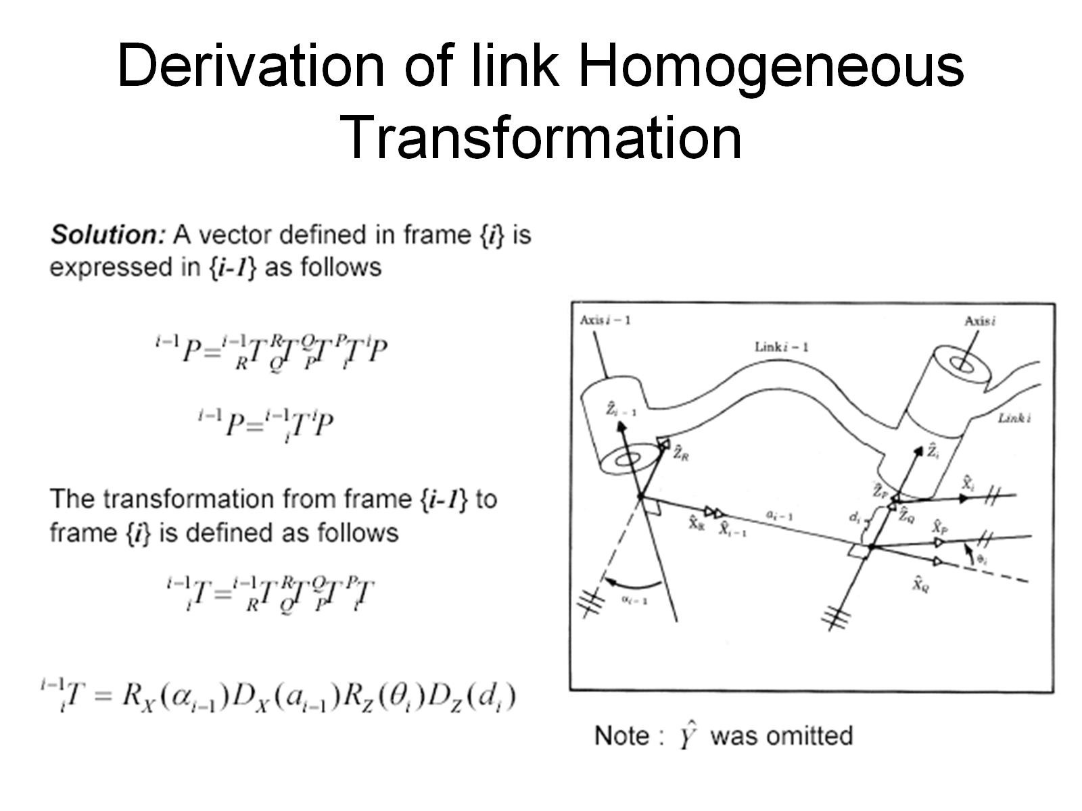
Derivation of link Homogeneous Transformation

Slide 30
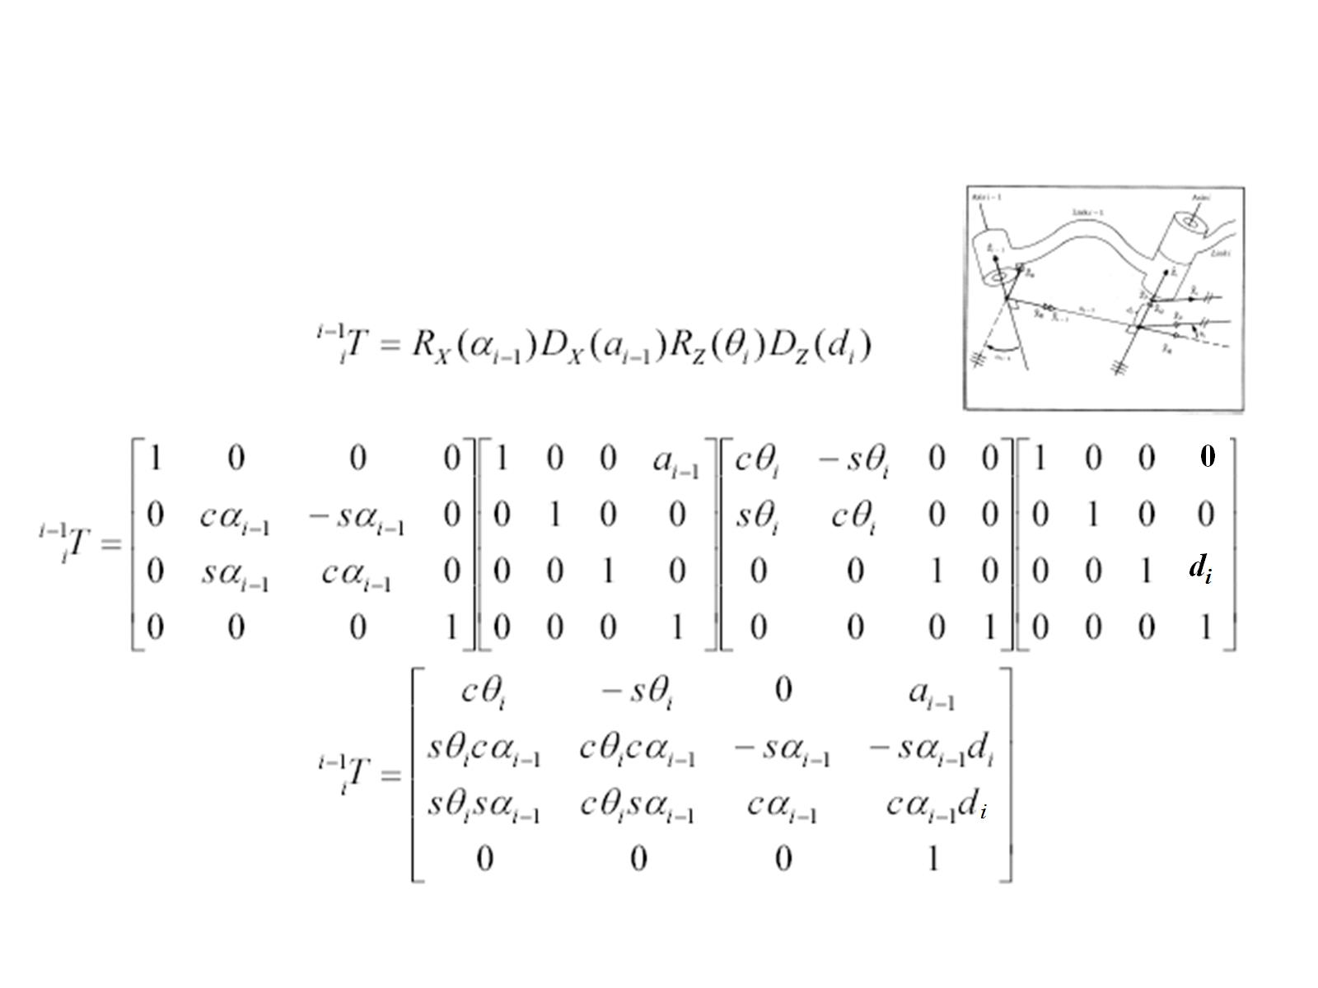

Slide 31
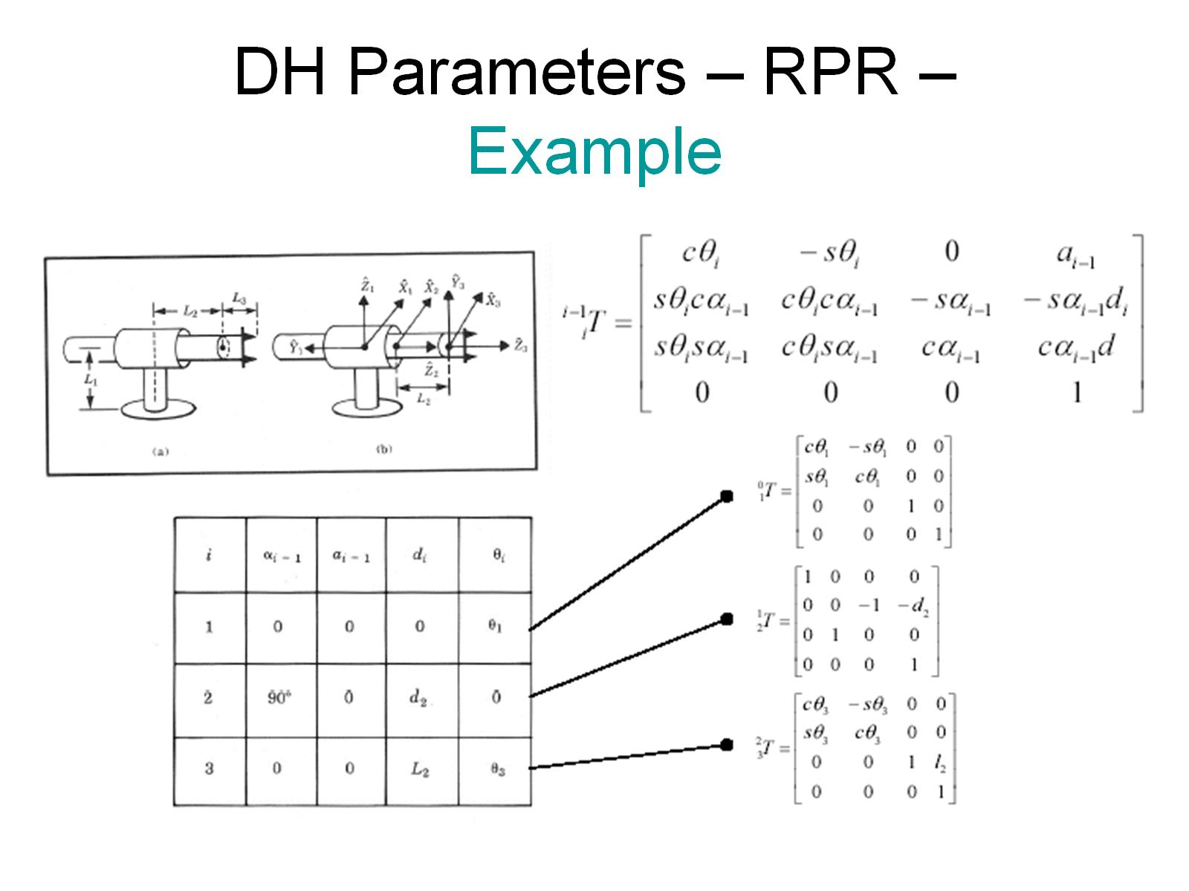
DH Parameters – RPR – Example

Slide 32
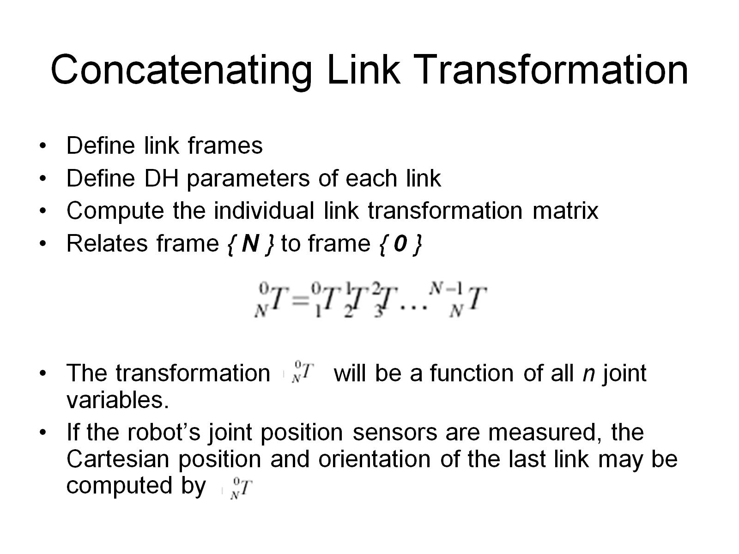
Concatenating Link Transformation

Slide 33
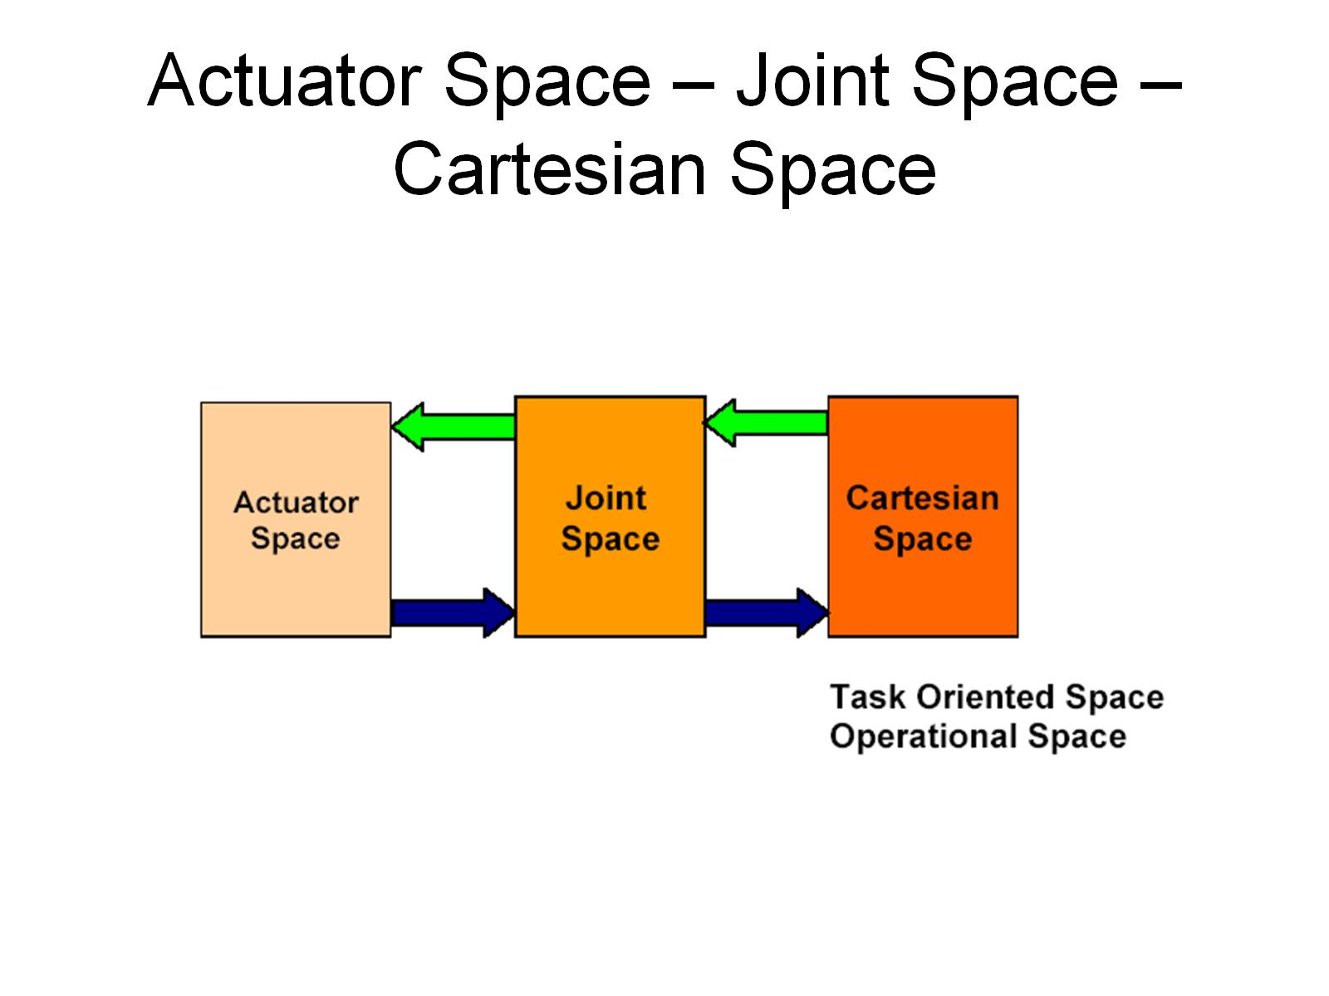
Actuator Space – Joint Space – Cartesian Space

Slide 34
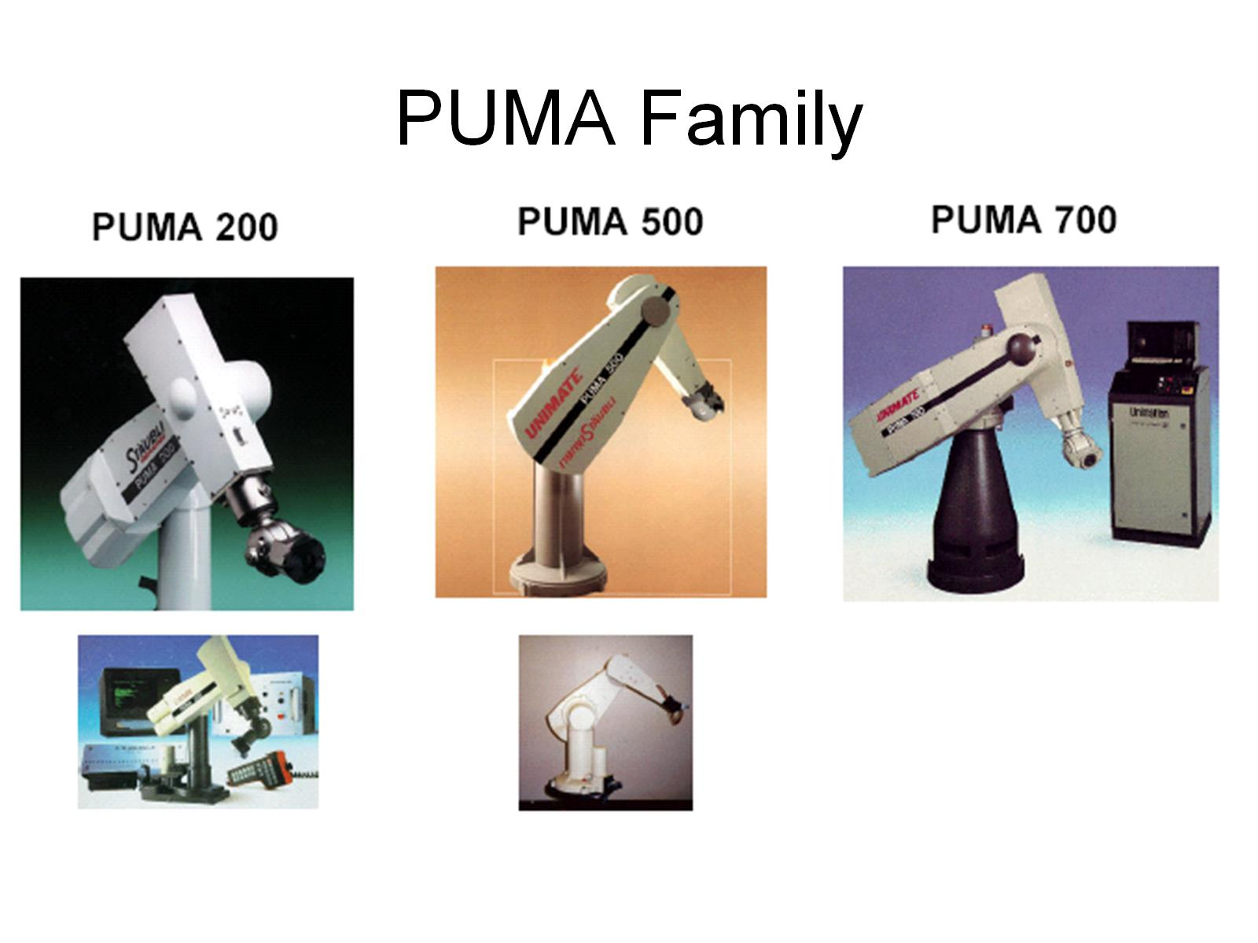
PUMA Family

Slide 35
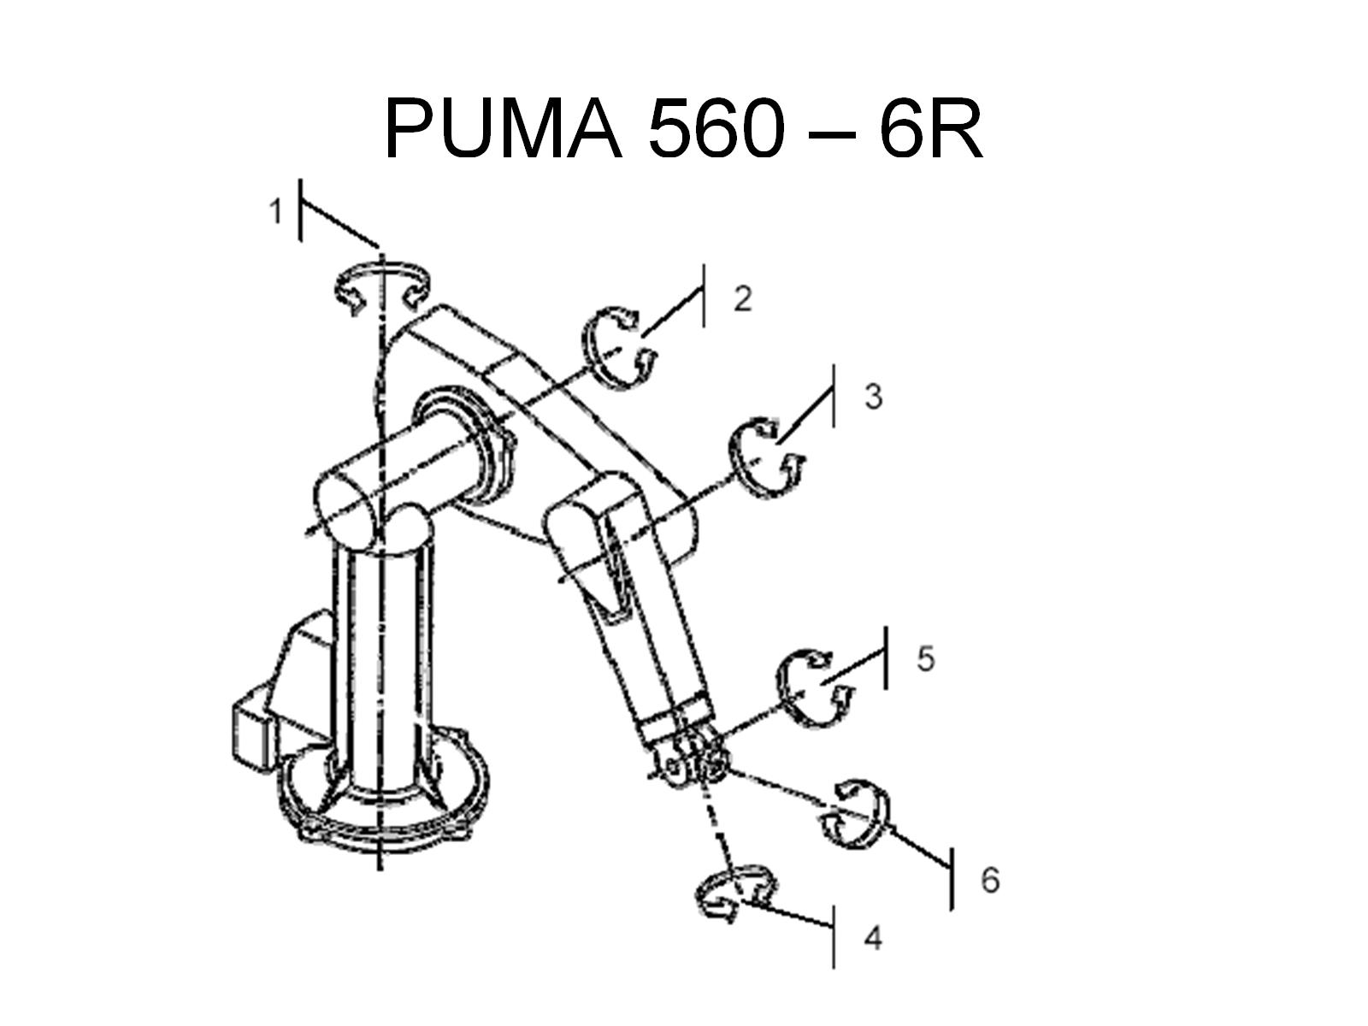
PUMA 560 – 6R

Slide 36
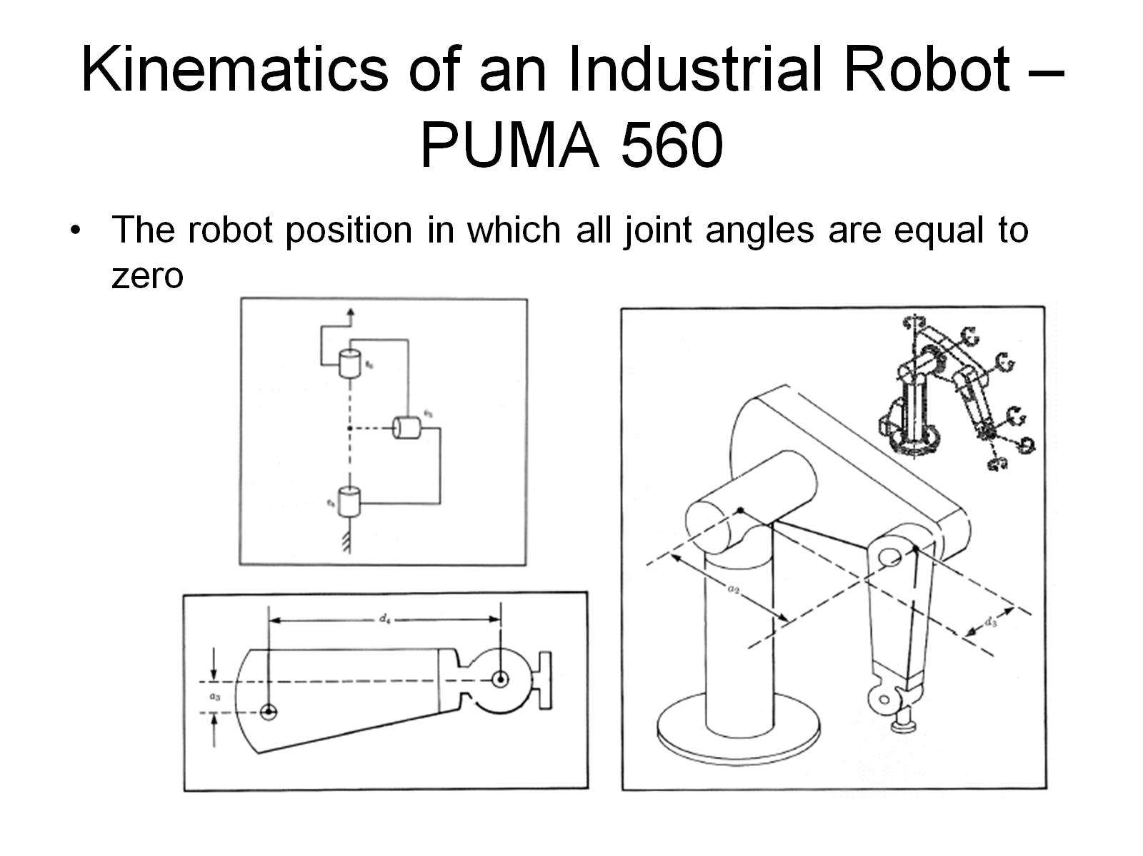
Kinematics of an Industrial Robot – PUMA 560

Slide 37
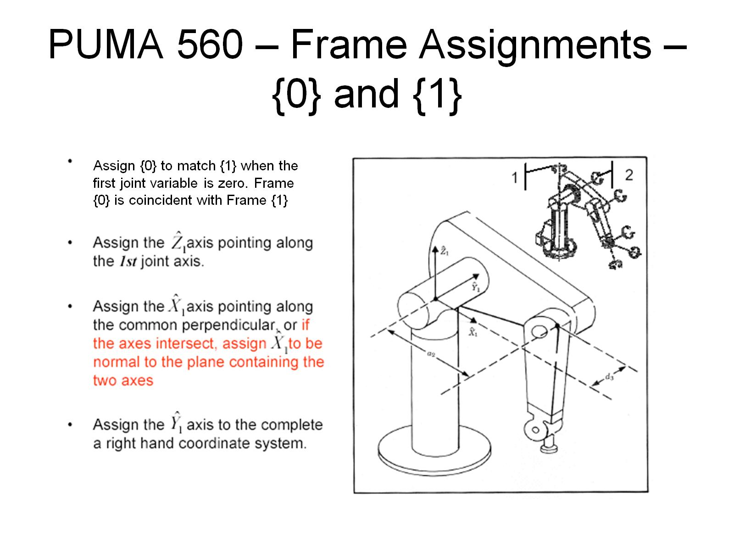
PUMA 560 – Frame Assignments – {0} and {1}

Slide 38
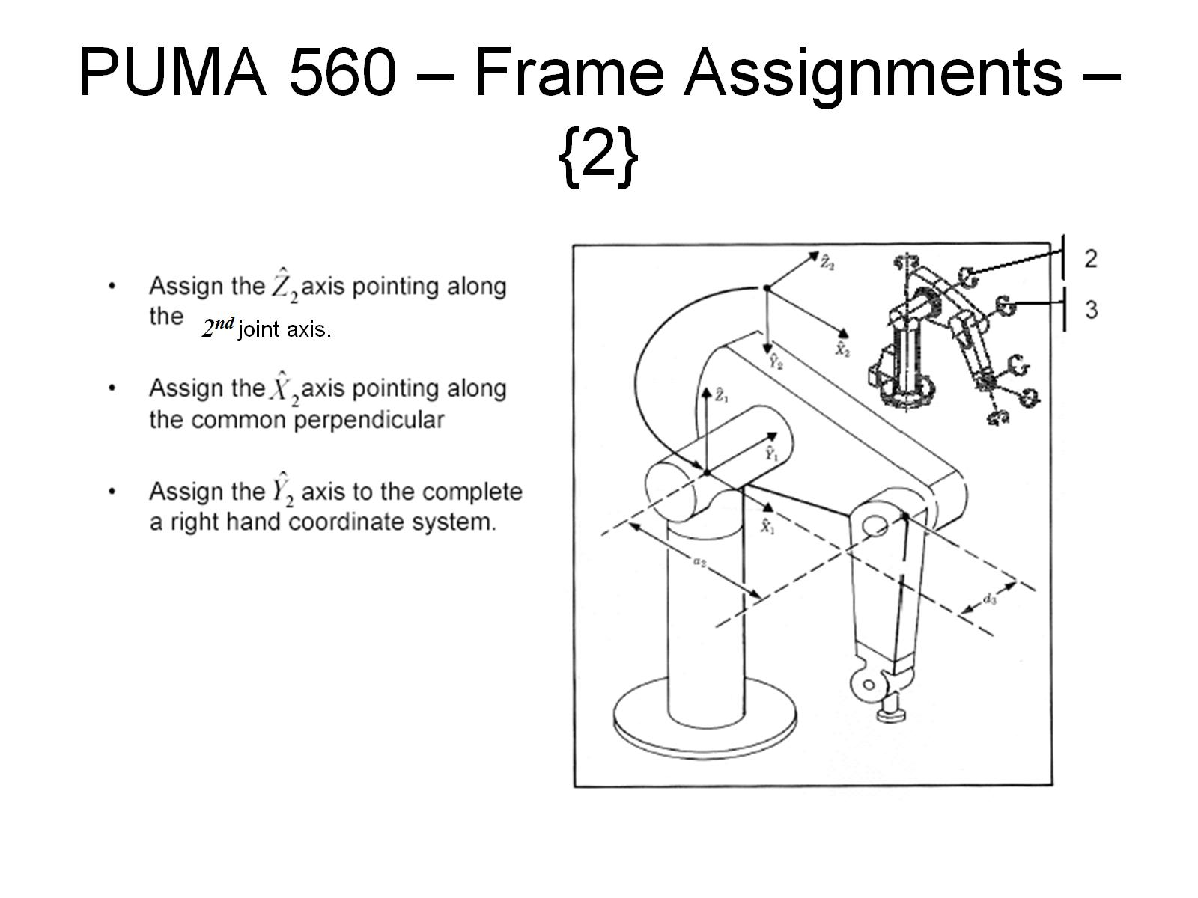
PUMA 560 – Frame Assignments – {2}

Slide 39
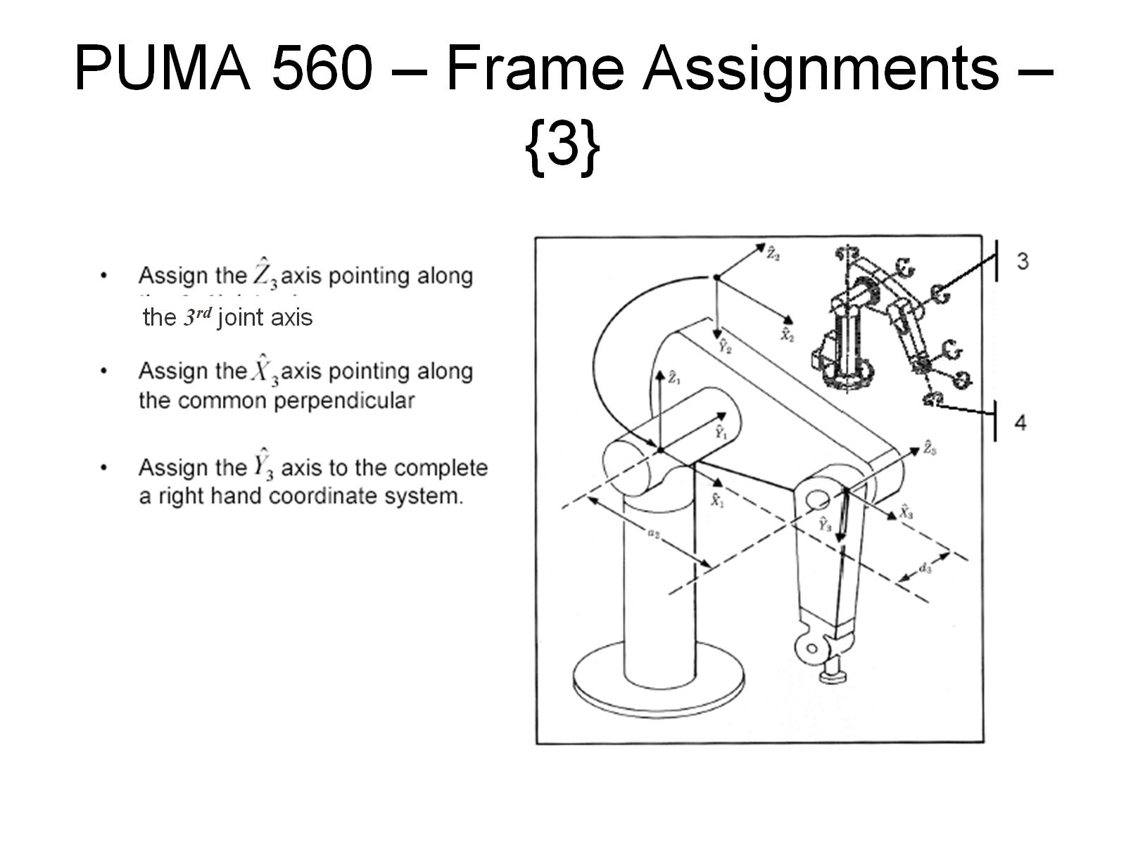
PUMA 560 – Frame Assignments – {3}

Slide 40
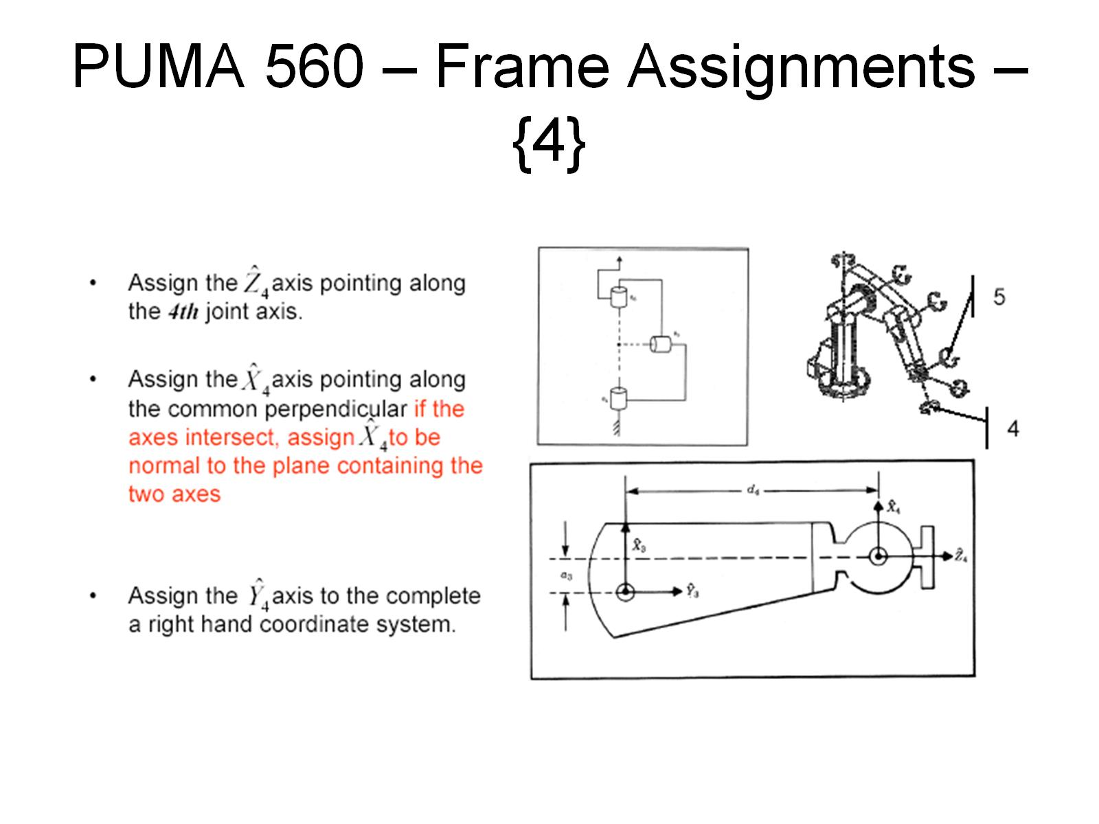
PUMA 560 – Frame Assignments – {4}

Slide 41
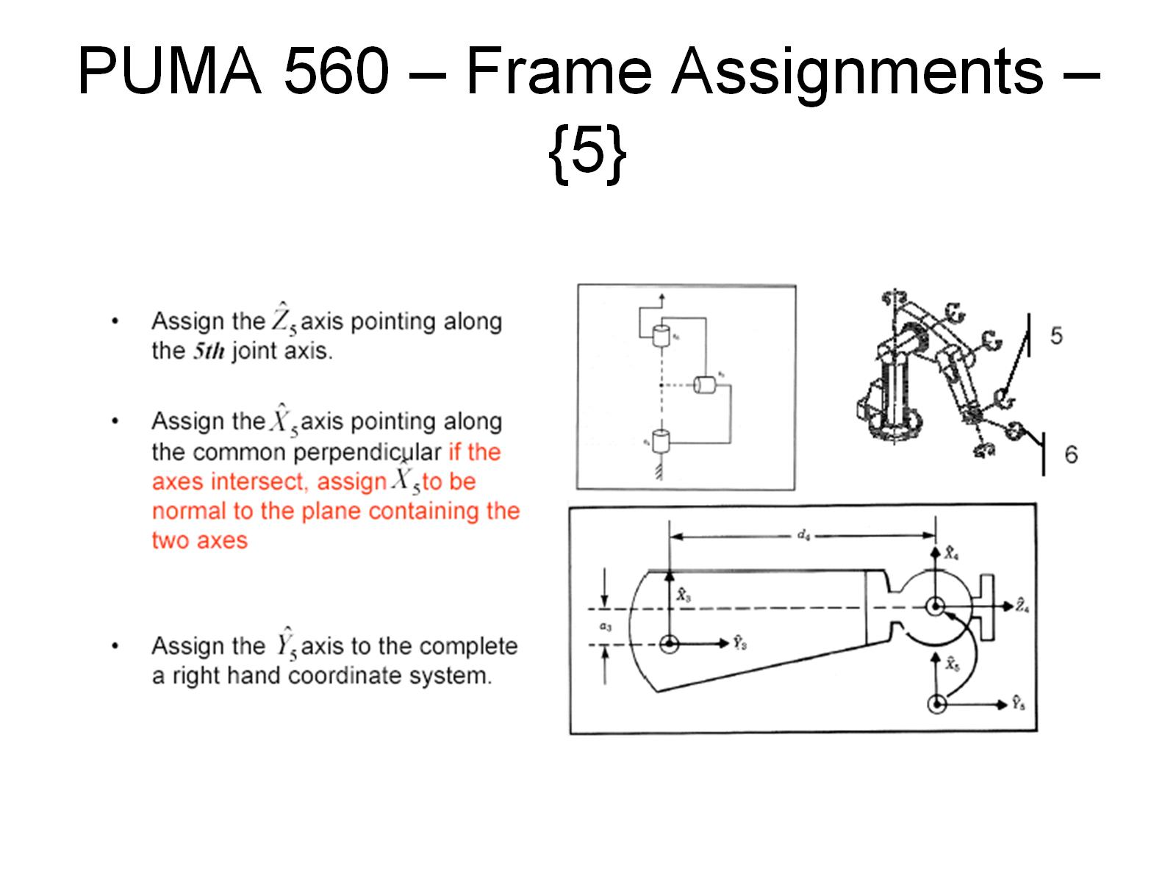
PUMA 560 – Frame Assignments – {5}

Slide 42
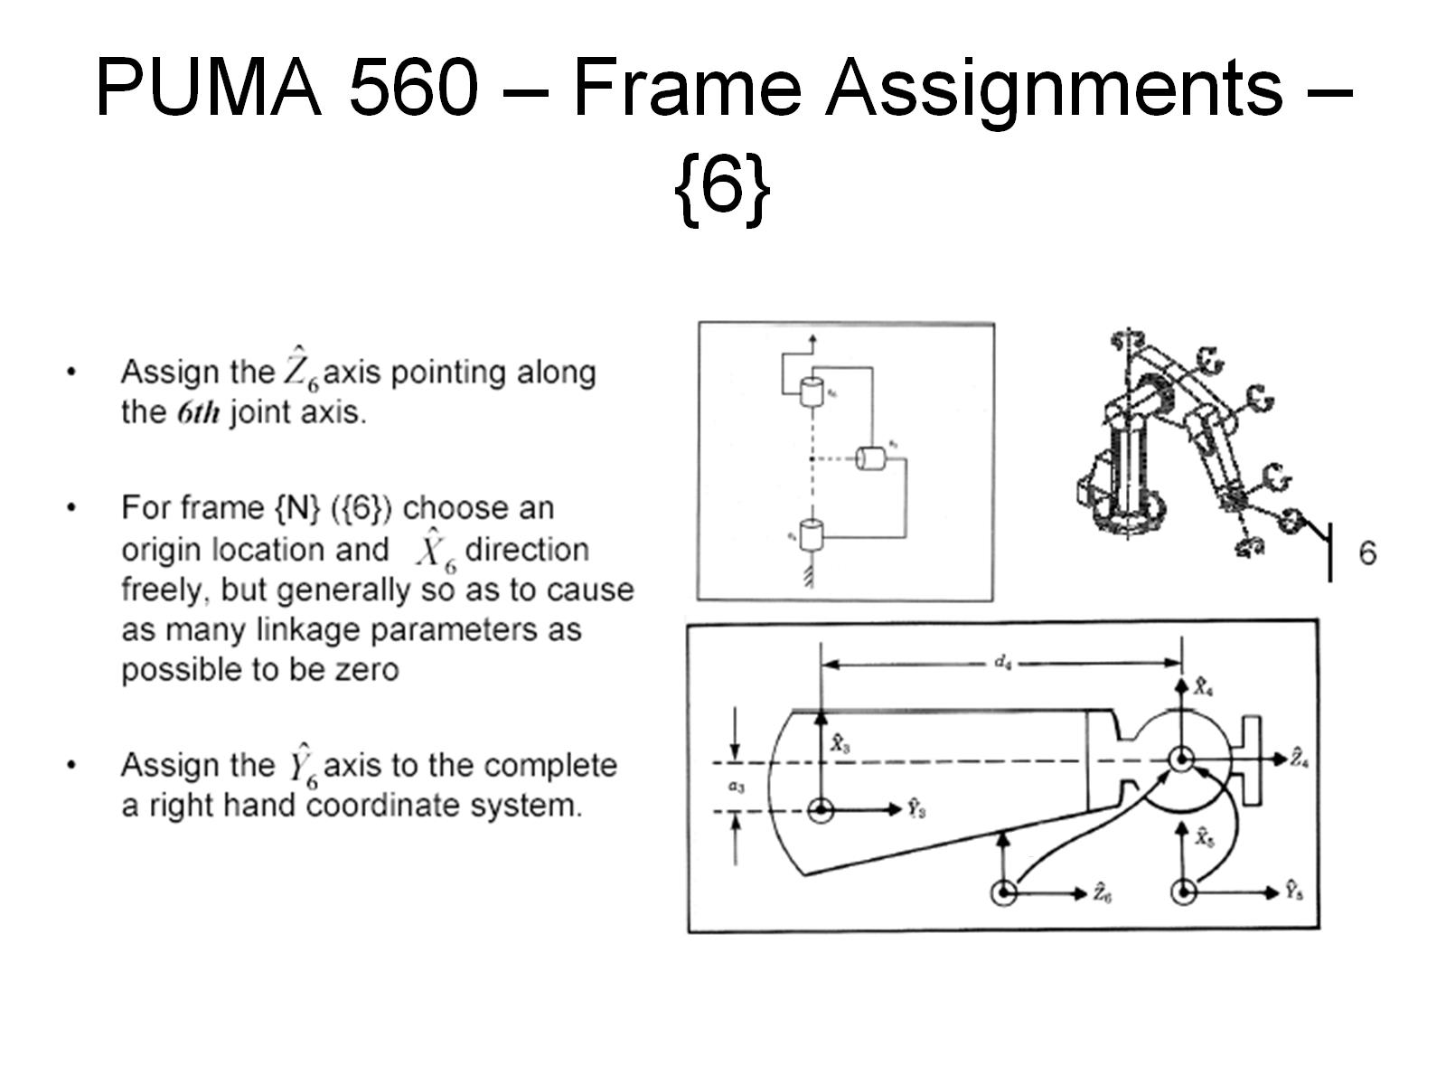
PUMA 560 – Frame Assignments – {6}

Slide 43
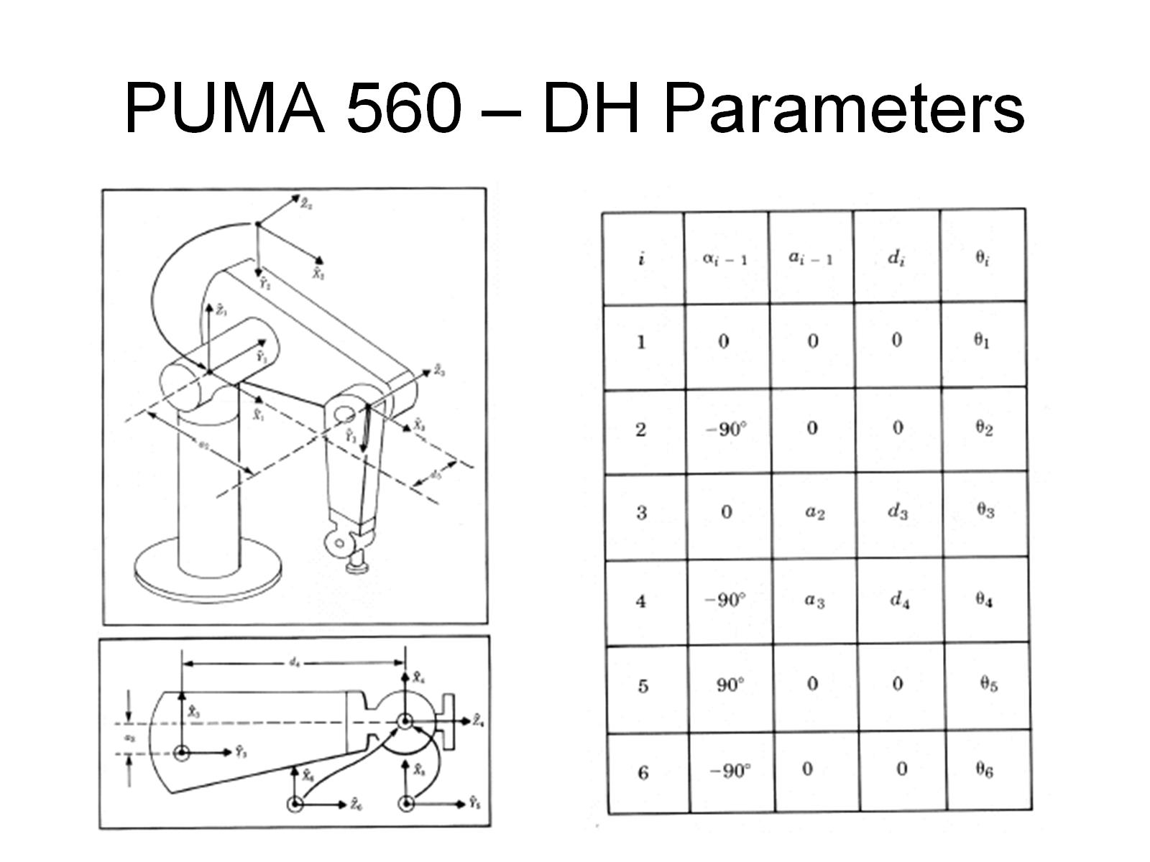
PUMA 560 – DH Parameters

Slide 44
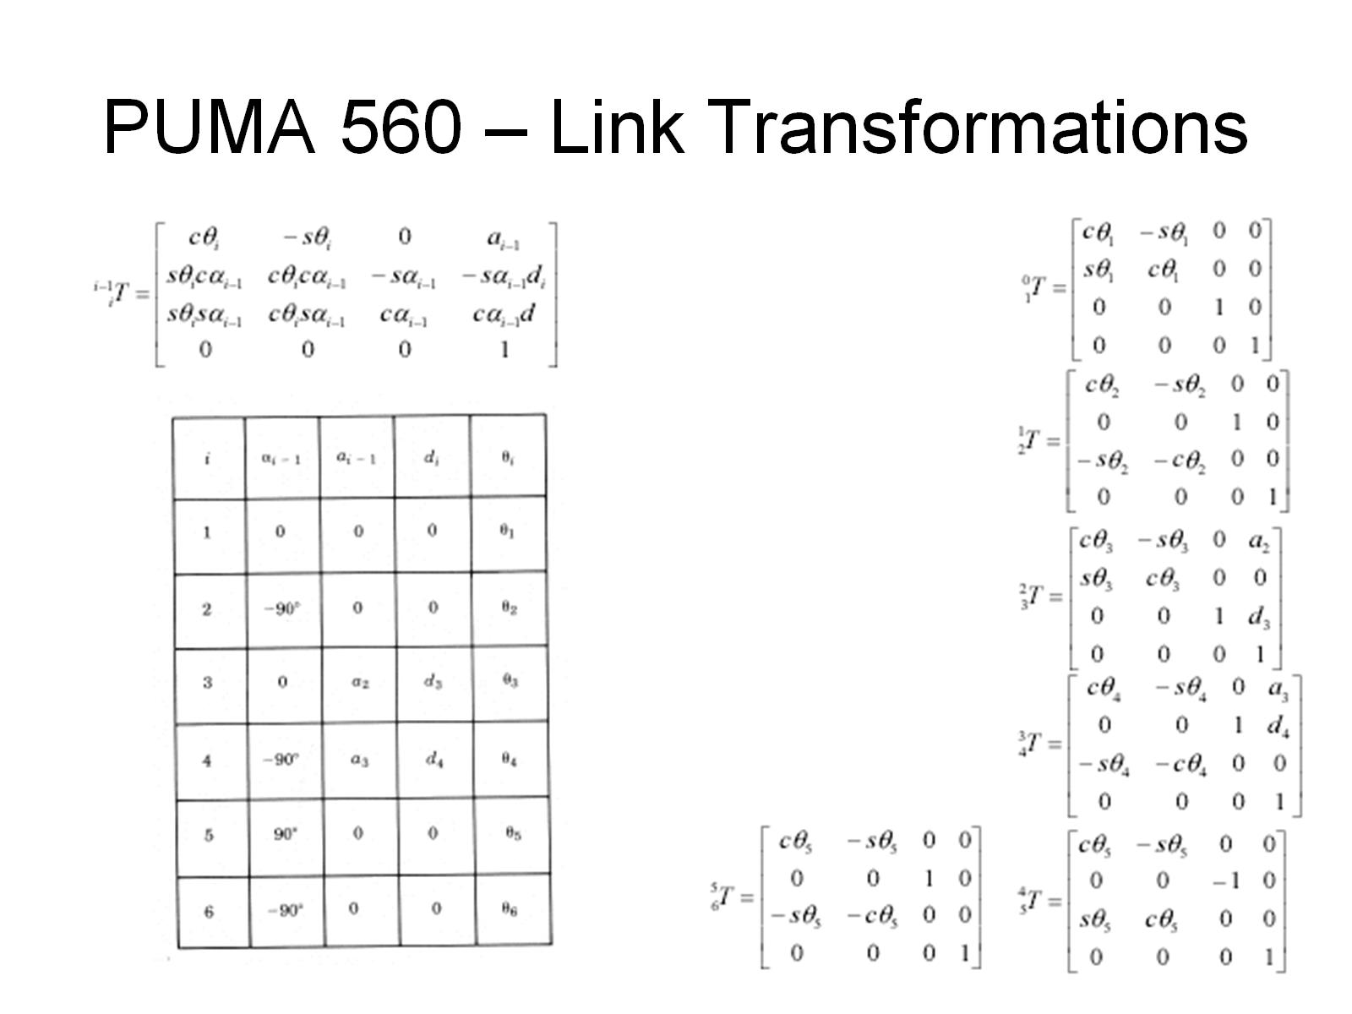
PUMA 560 – Link Transformations

Slide 45
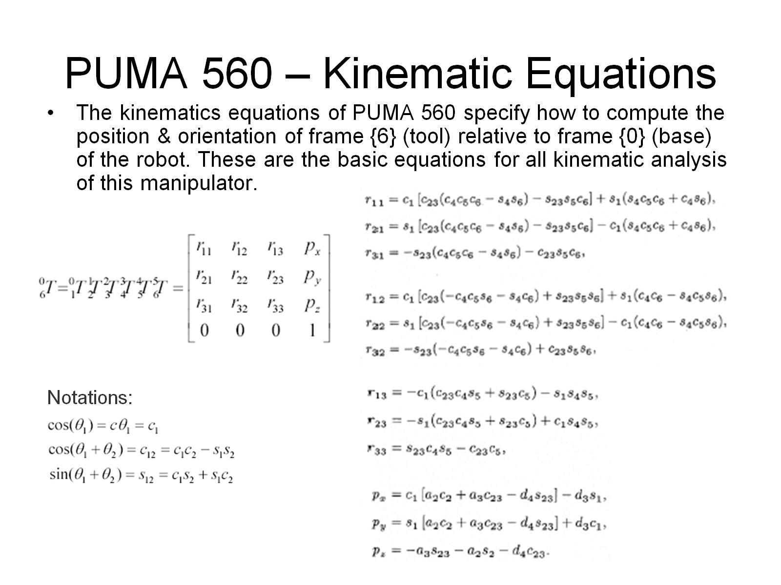
PUMA 560 – Kinematic Equations

Slide 46
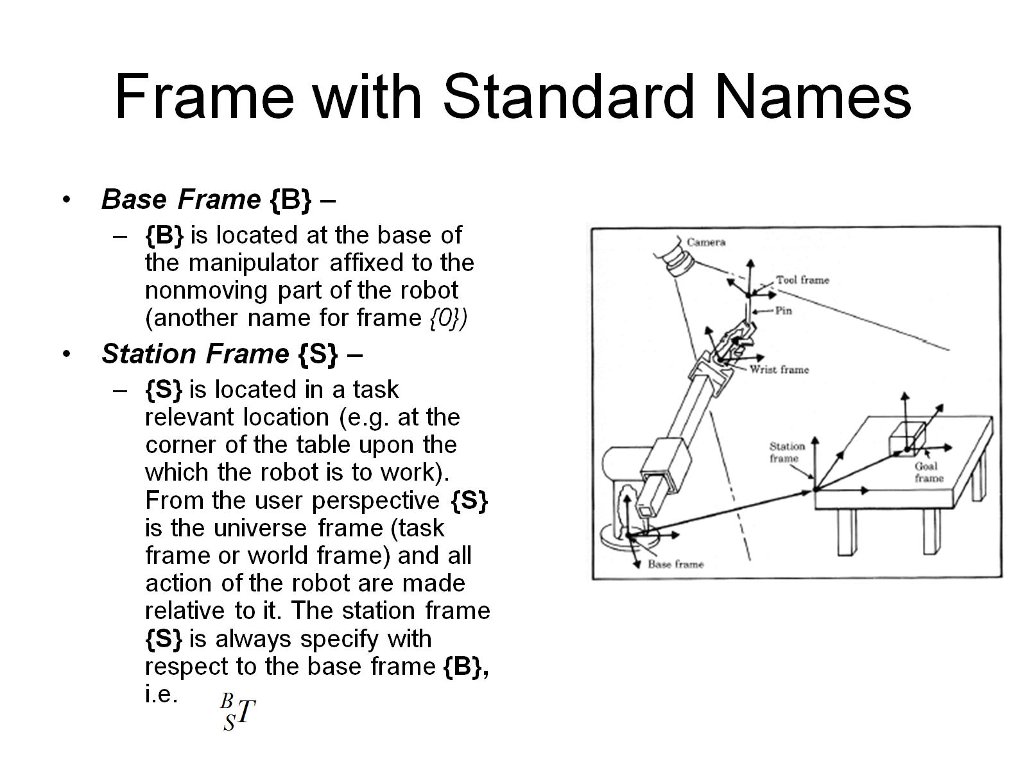
Frame with Standard Names

Slide 47
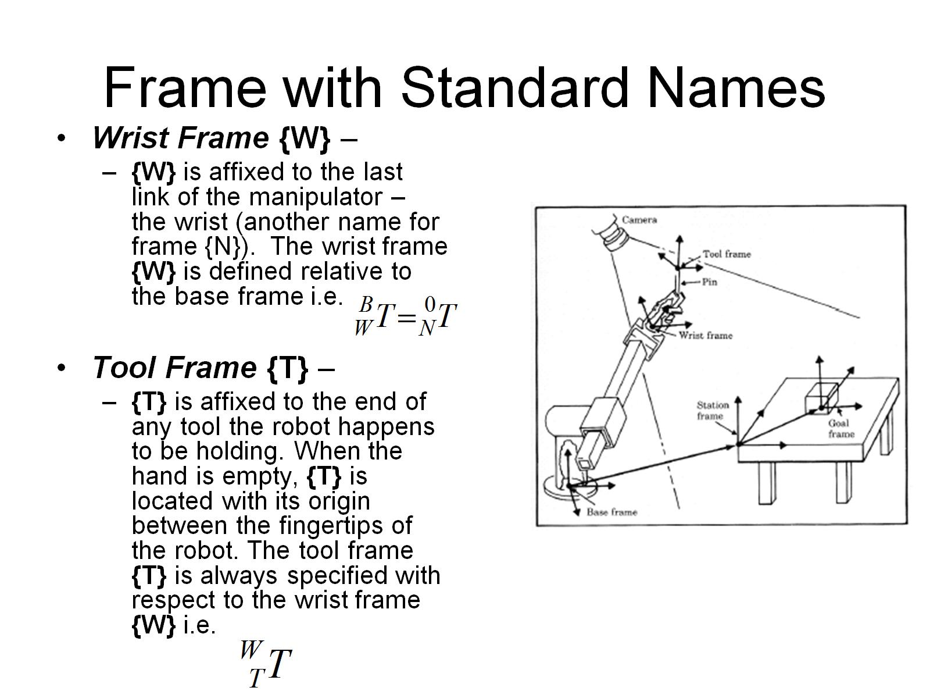
Frame with Standard Names

Slide 48
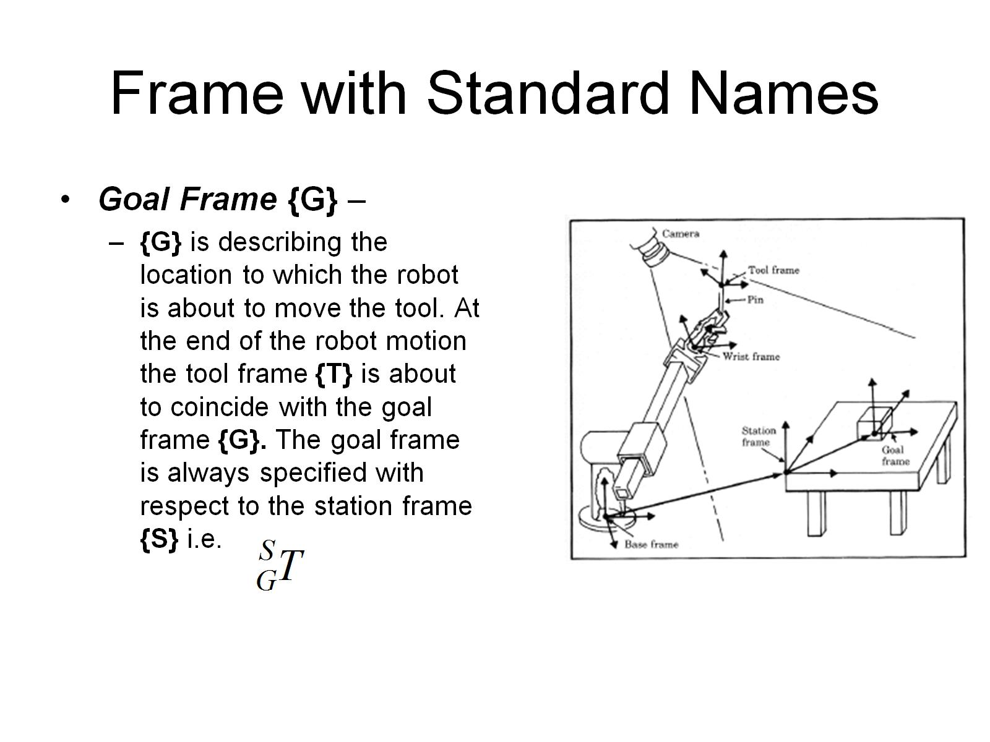
Frame with Standard Names

Slide 49
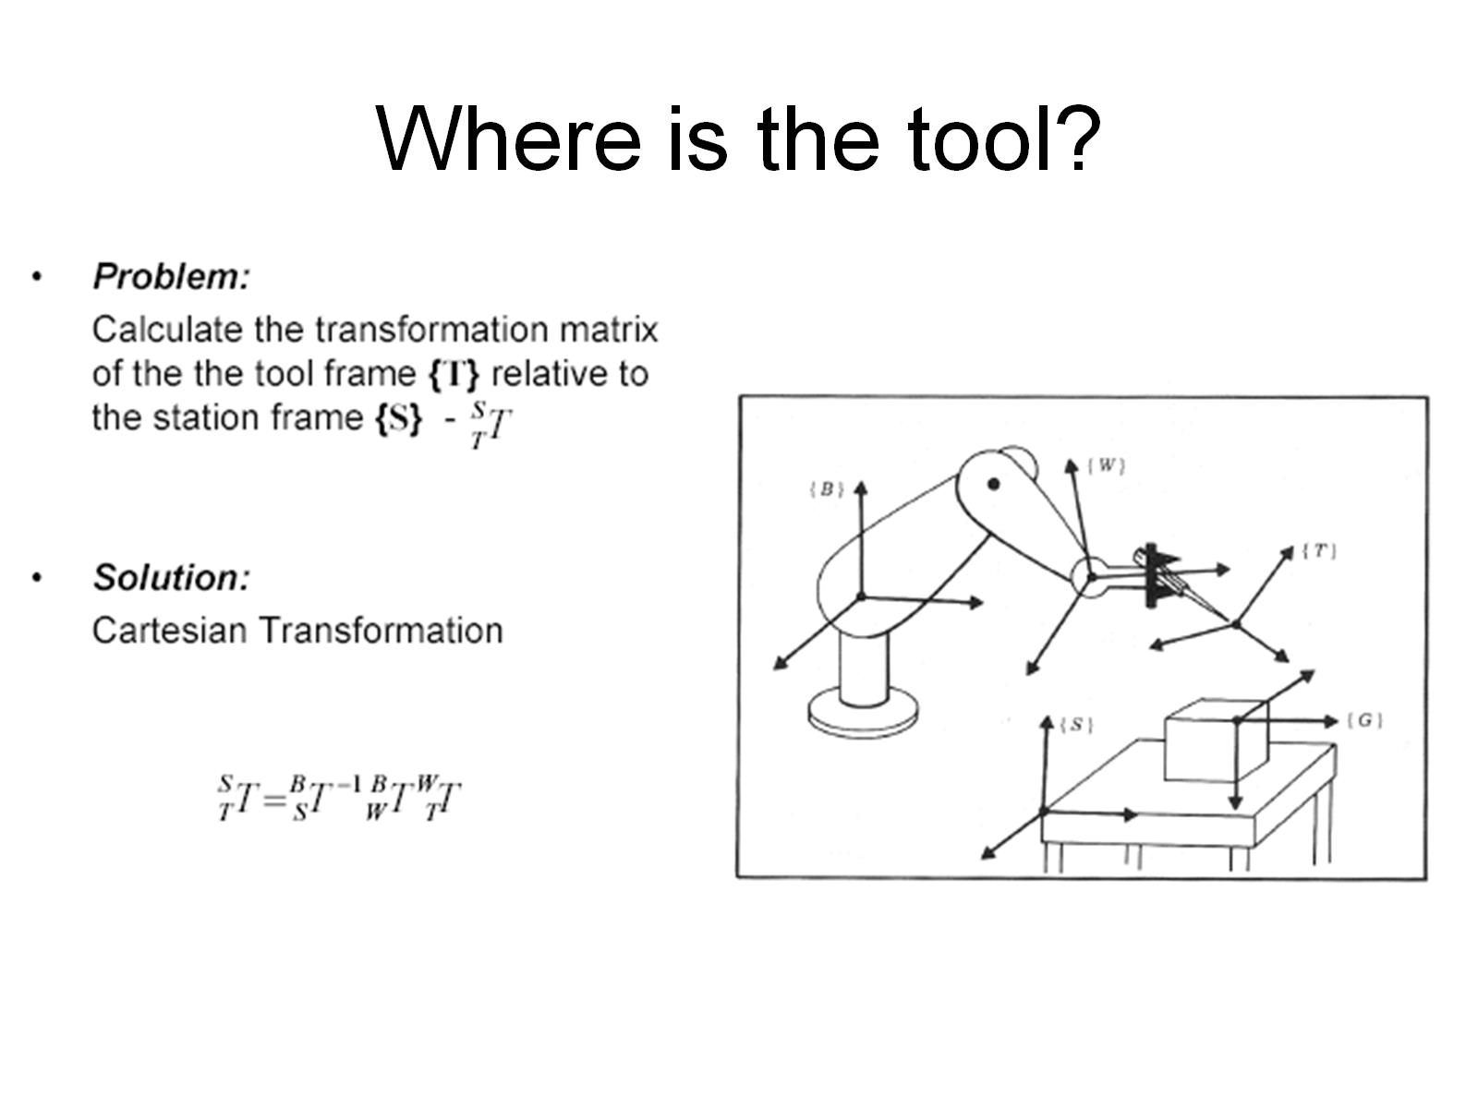
Where is the tool?

Slide 50
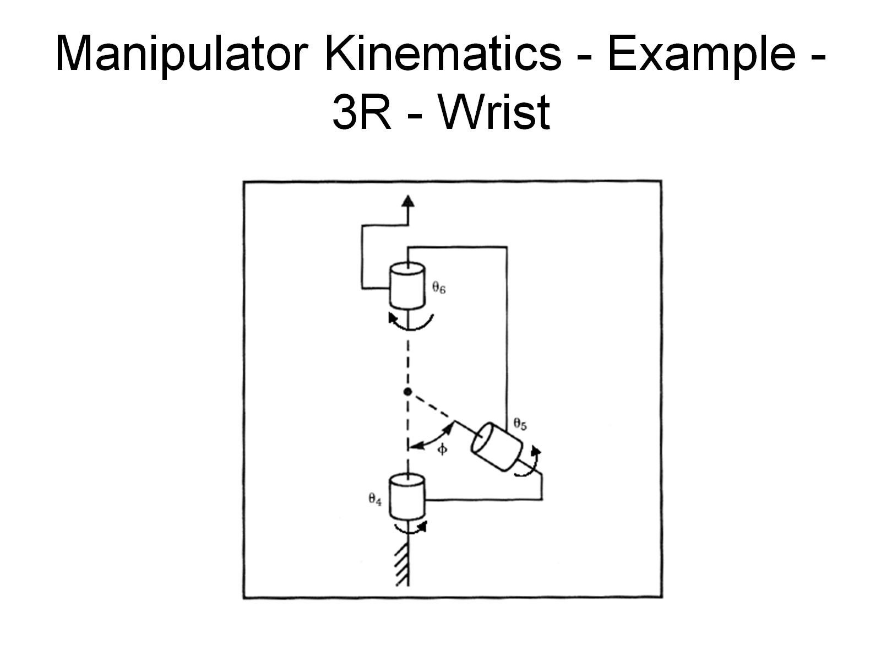
Manipulator Kinematics - Example - 3R - Wrist

Slide 51

Manipulator Kinematics - Example - 3R - Wrist

Slide 52

Manipulator Kinematics – Example - PRR

Slide 53

Manipulator Kinematics – Example - PRR

Slide 54

Manipulator Kinematics – Example – 3P

Slide 55

Manipulator Kinematics – Example – 3P

Slide 56

Manipulator Kinematics – Example – PRRR

Slide 57

Manipulator Kinematics – Example – PRRR

Slide 58

Manipulator Kinematics – Example – 3R

Slide 59

Manipulator Kinematics – Example – 3R

Slide 60

Manipulator Kinematics – Example – 3R

Slide 61

Manipulator Kinematics – Example – 3R

Slide 62

Manipulator Kinematics – Example – RRPRR

Slide 63

Manipulator Kinematics – Example – RRPRR (2RP2R)

Slide 64

Manipulator Kinematics – Example – RRPRR (2RP2R)

Slide 65

Link Frame Attachment Procedure - Summary

Slide 66

DH Parameters - Review

Slide 67

Derivation of Link Homogeneous Transformation

